Slide 1
Drawing Class #1!
Presented by Karen Kliethermes

Slide 2
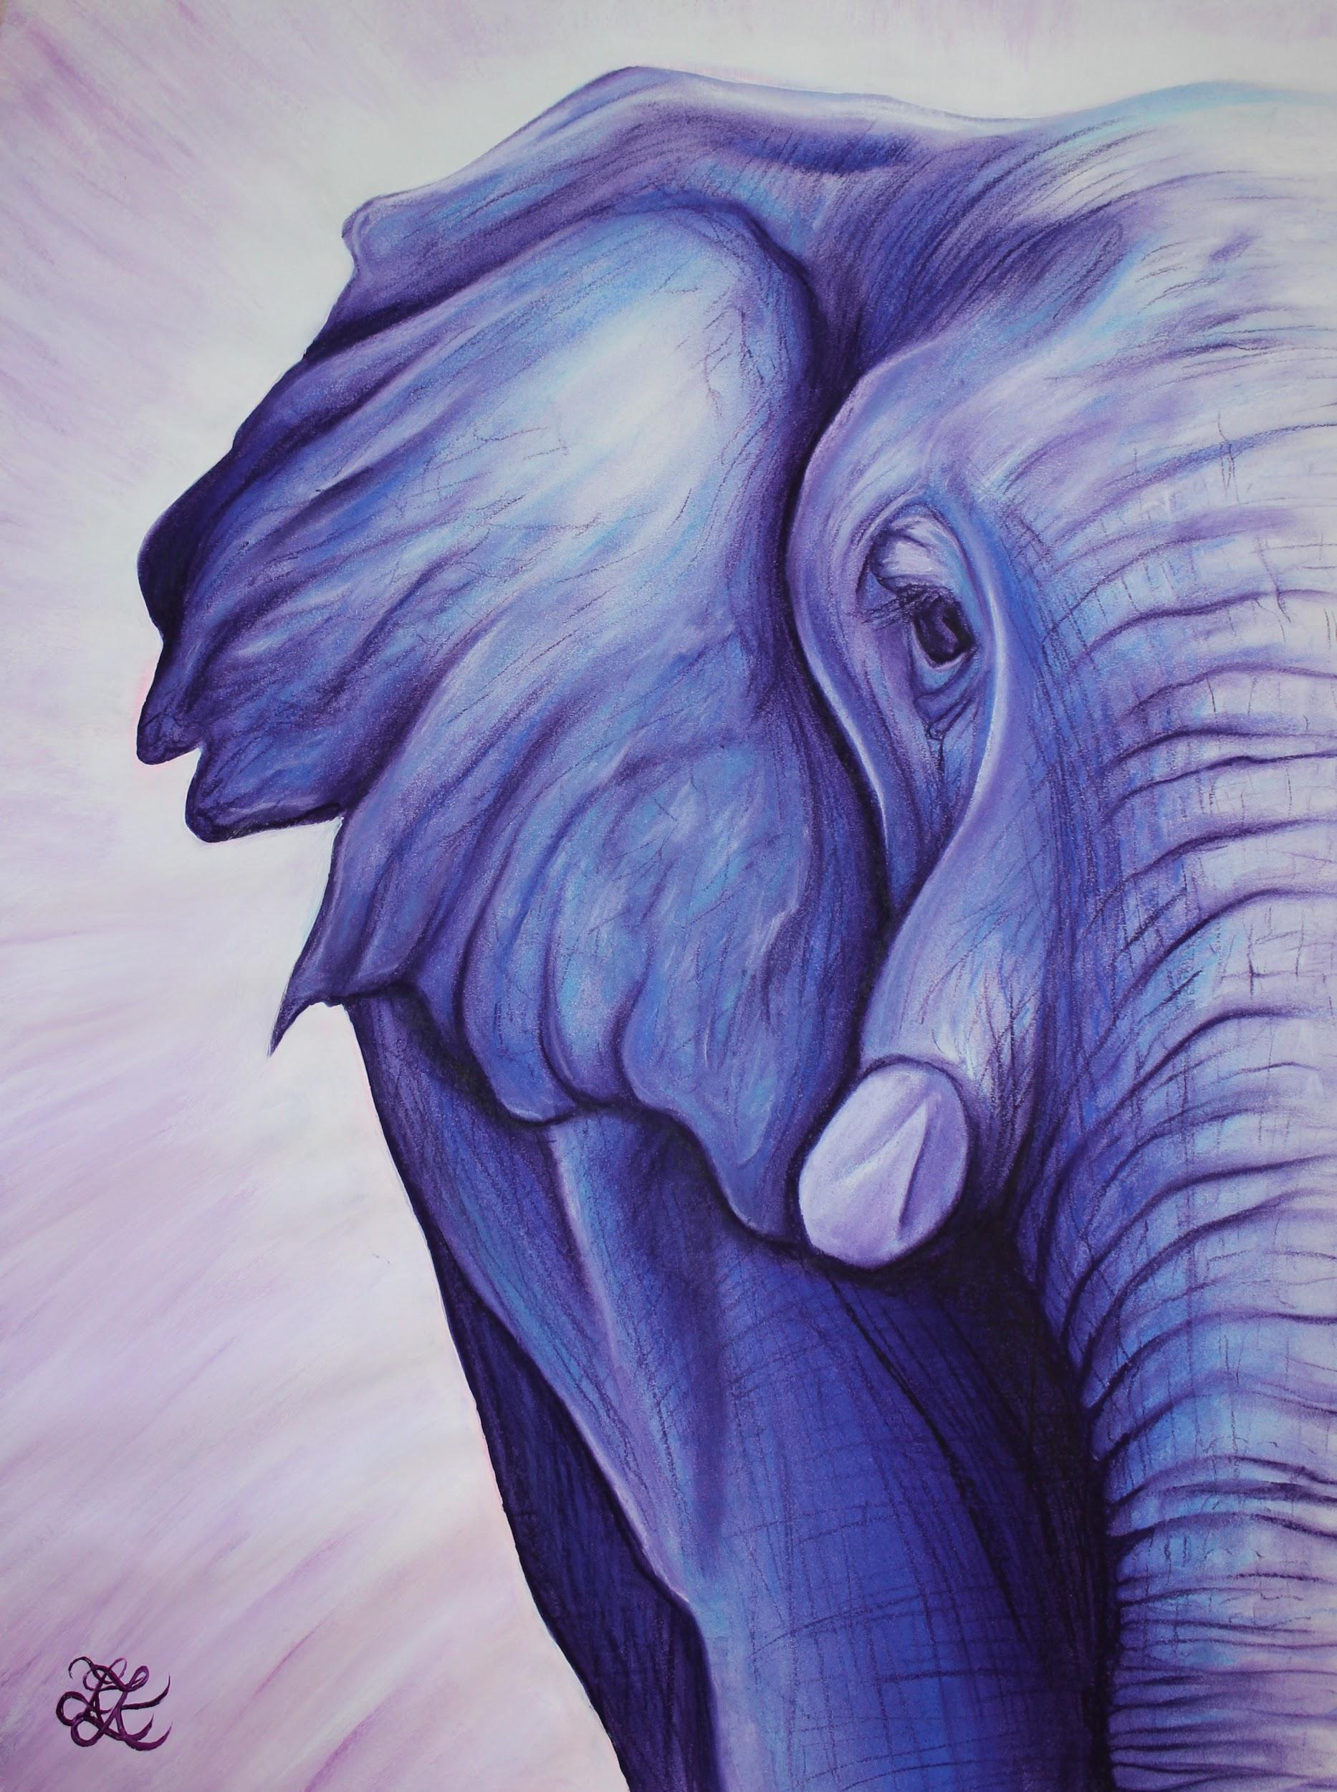
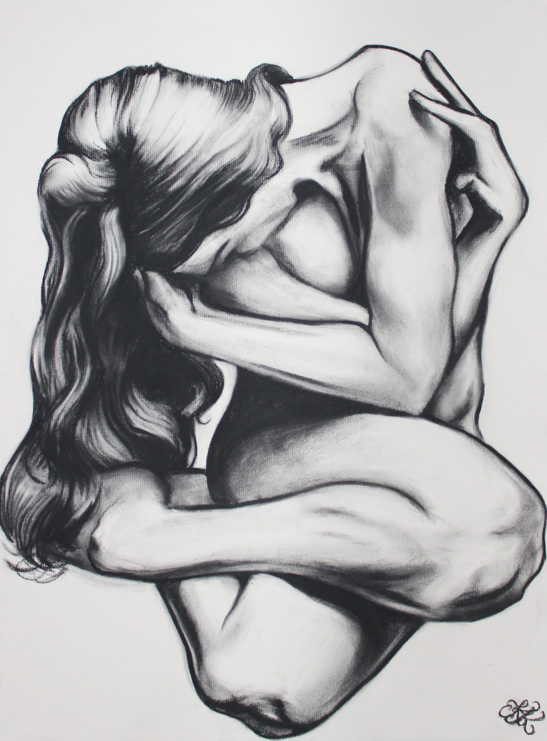
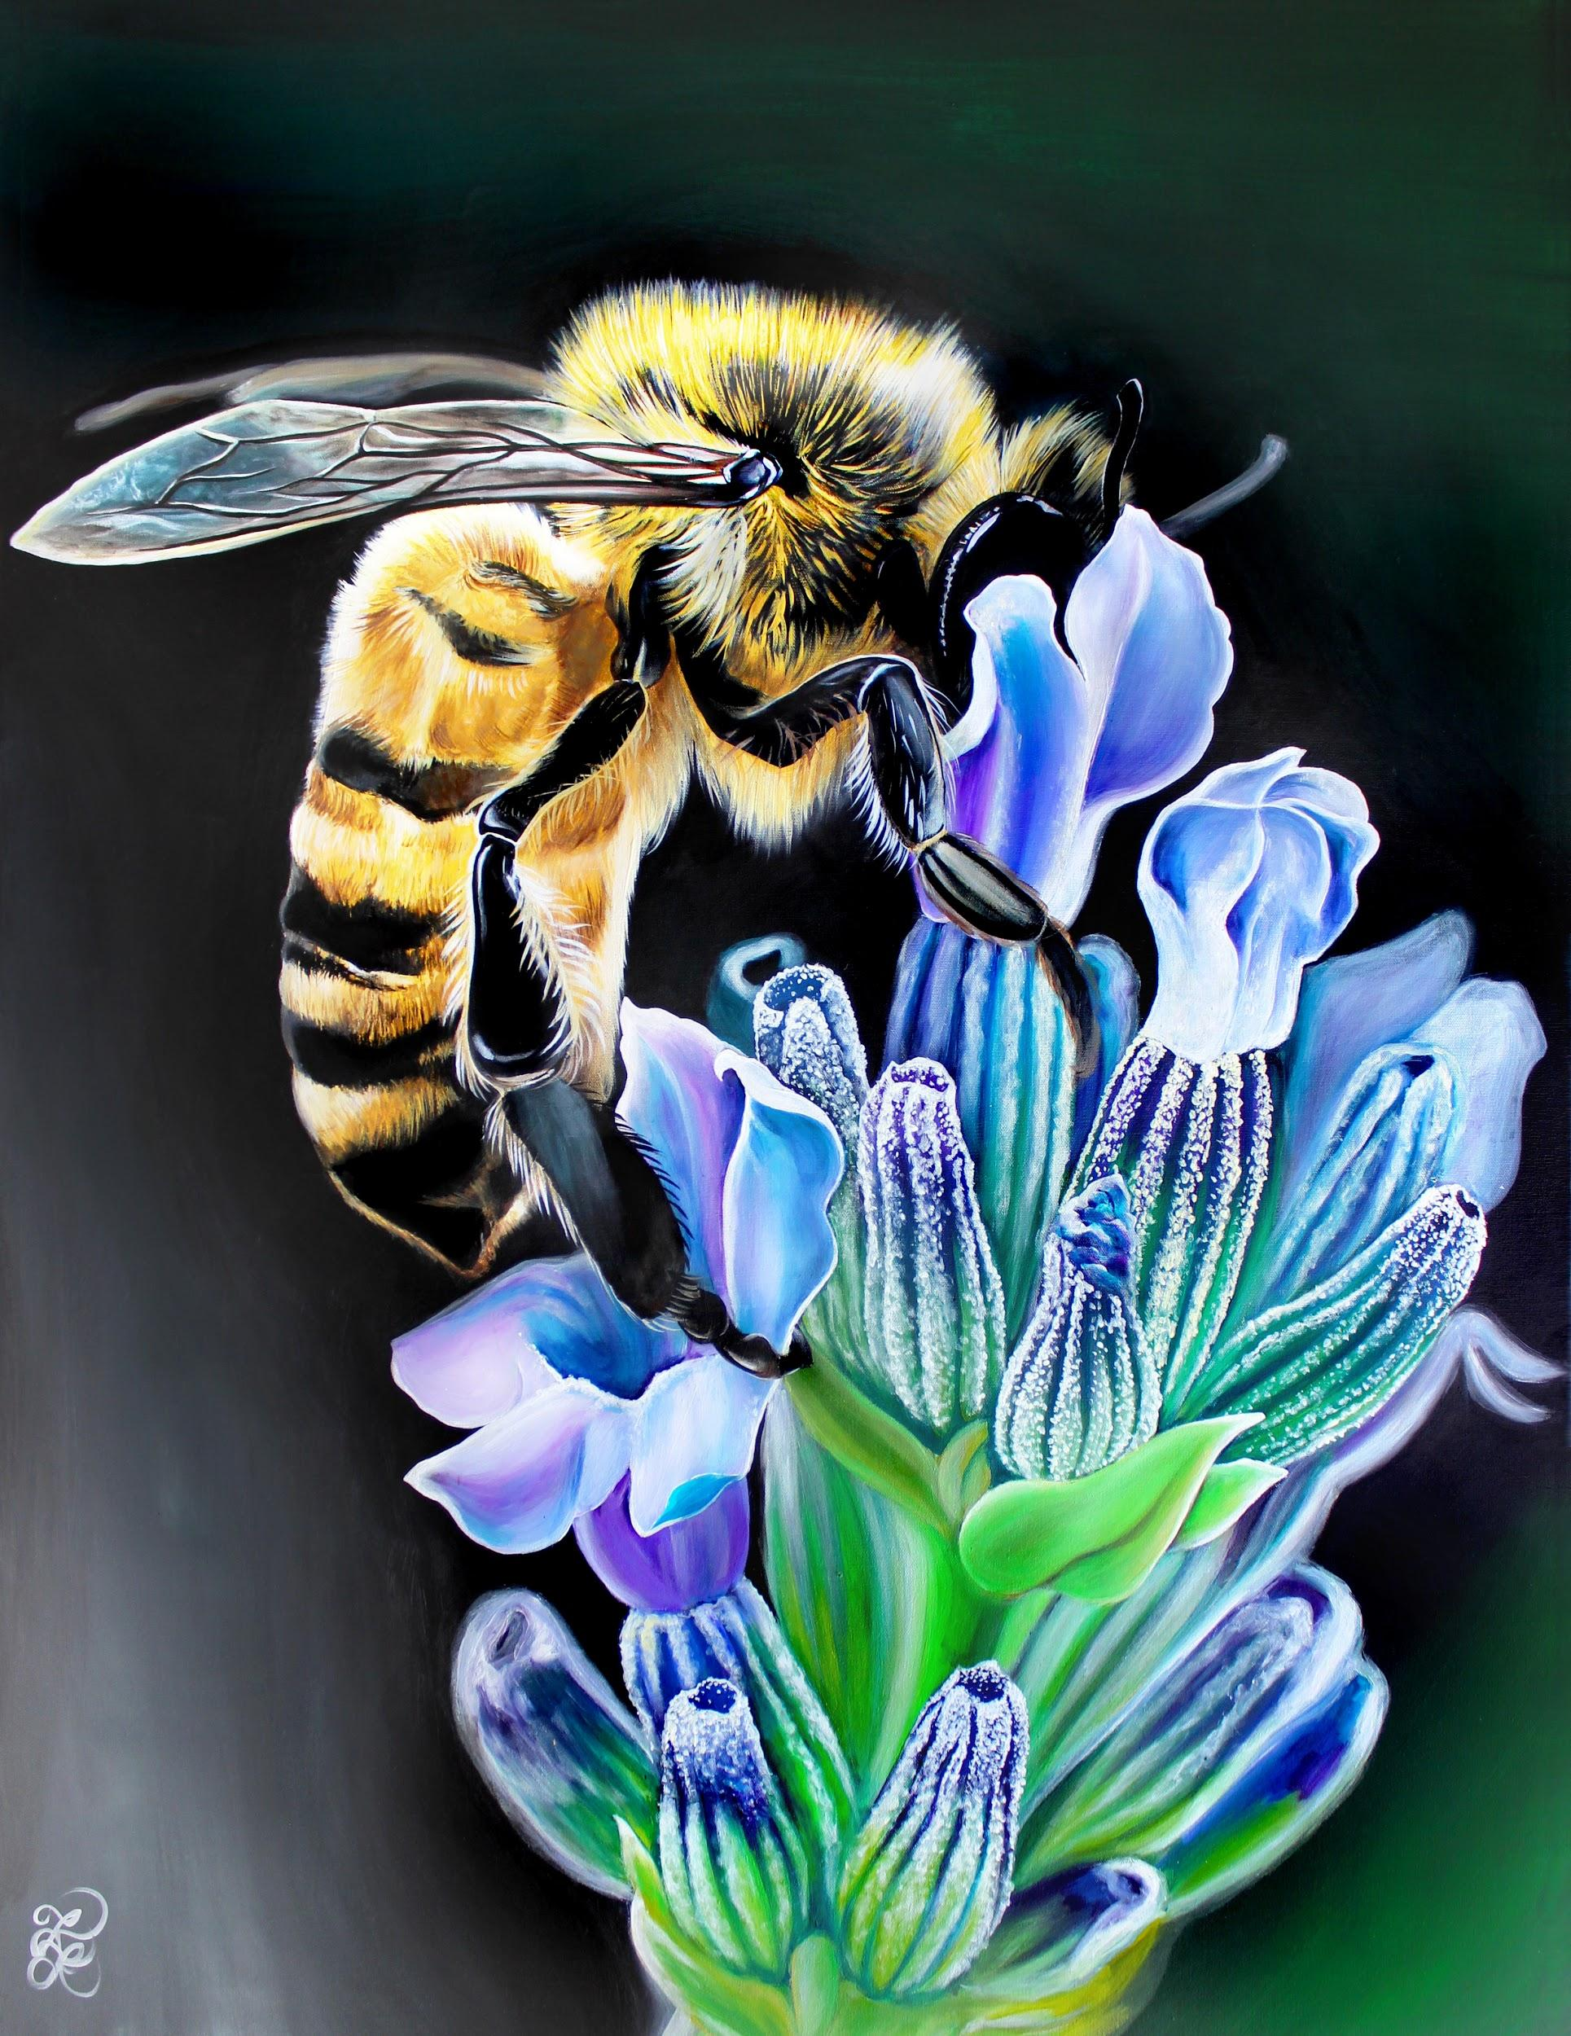
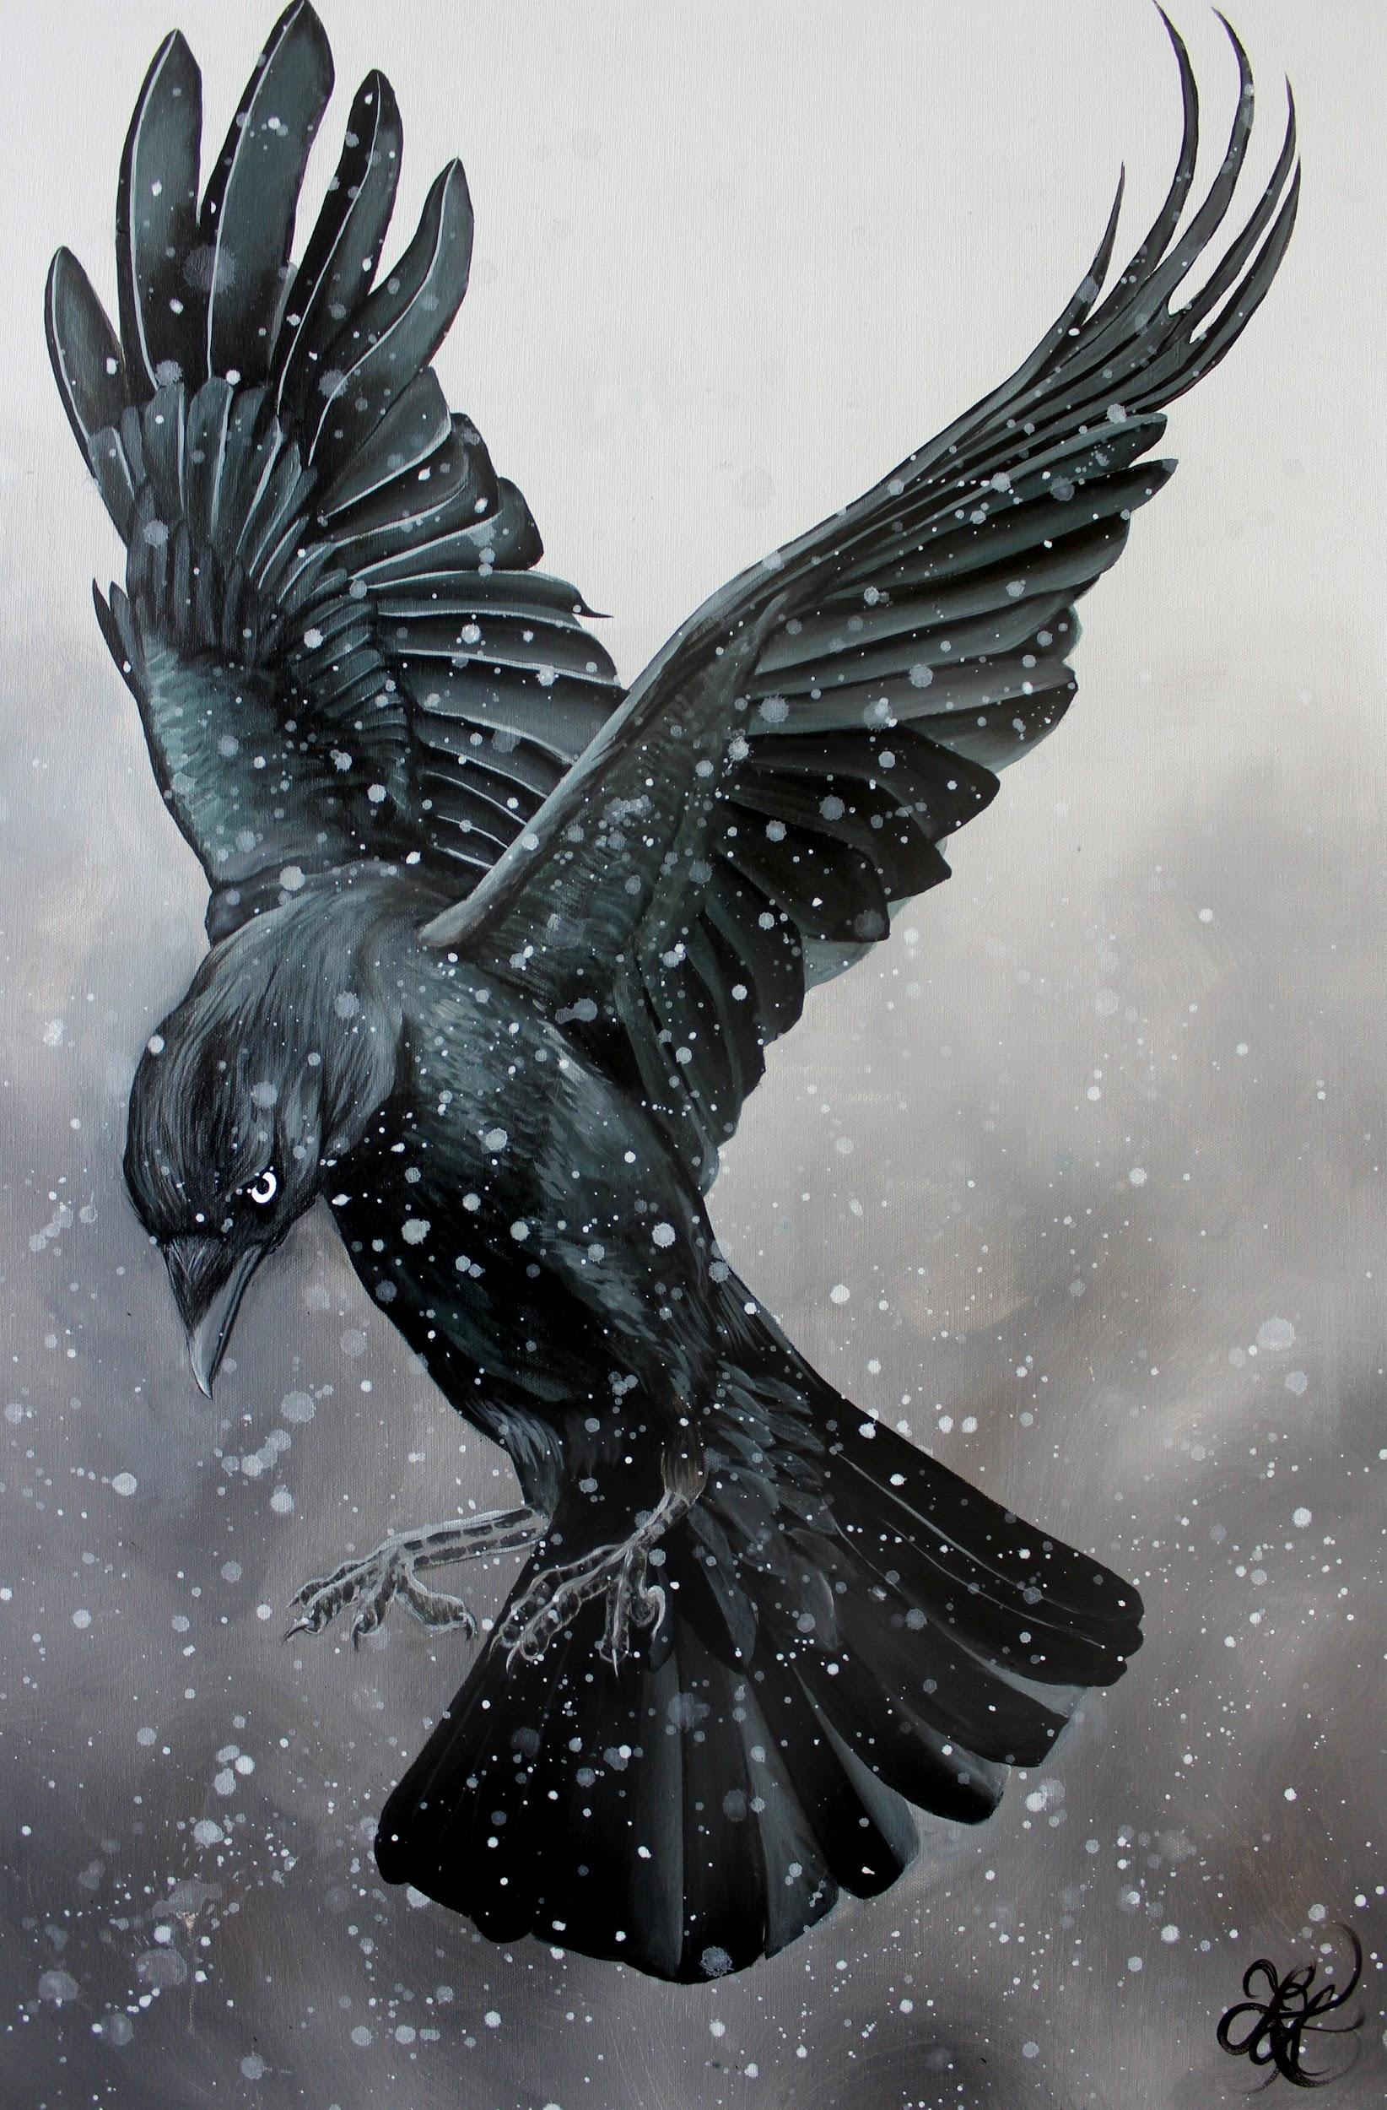
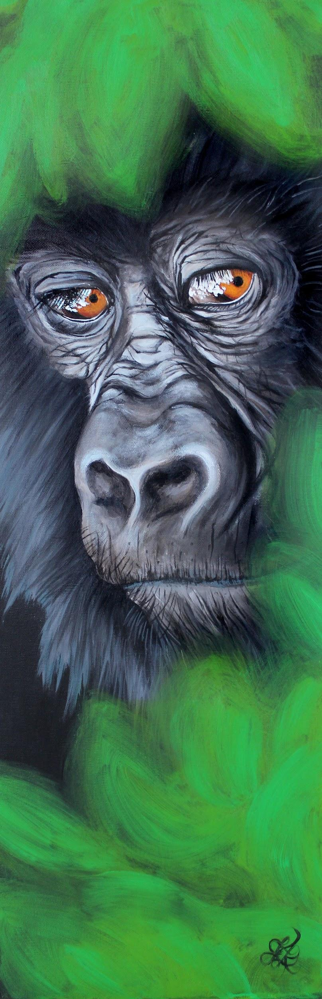
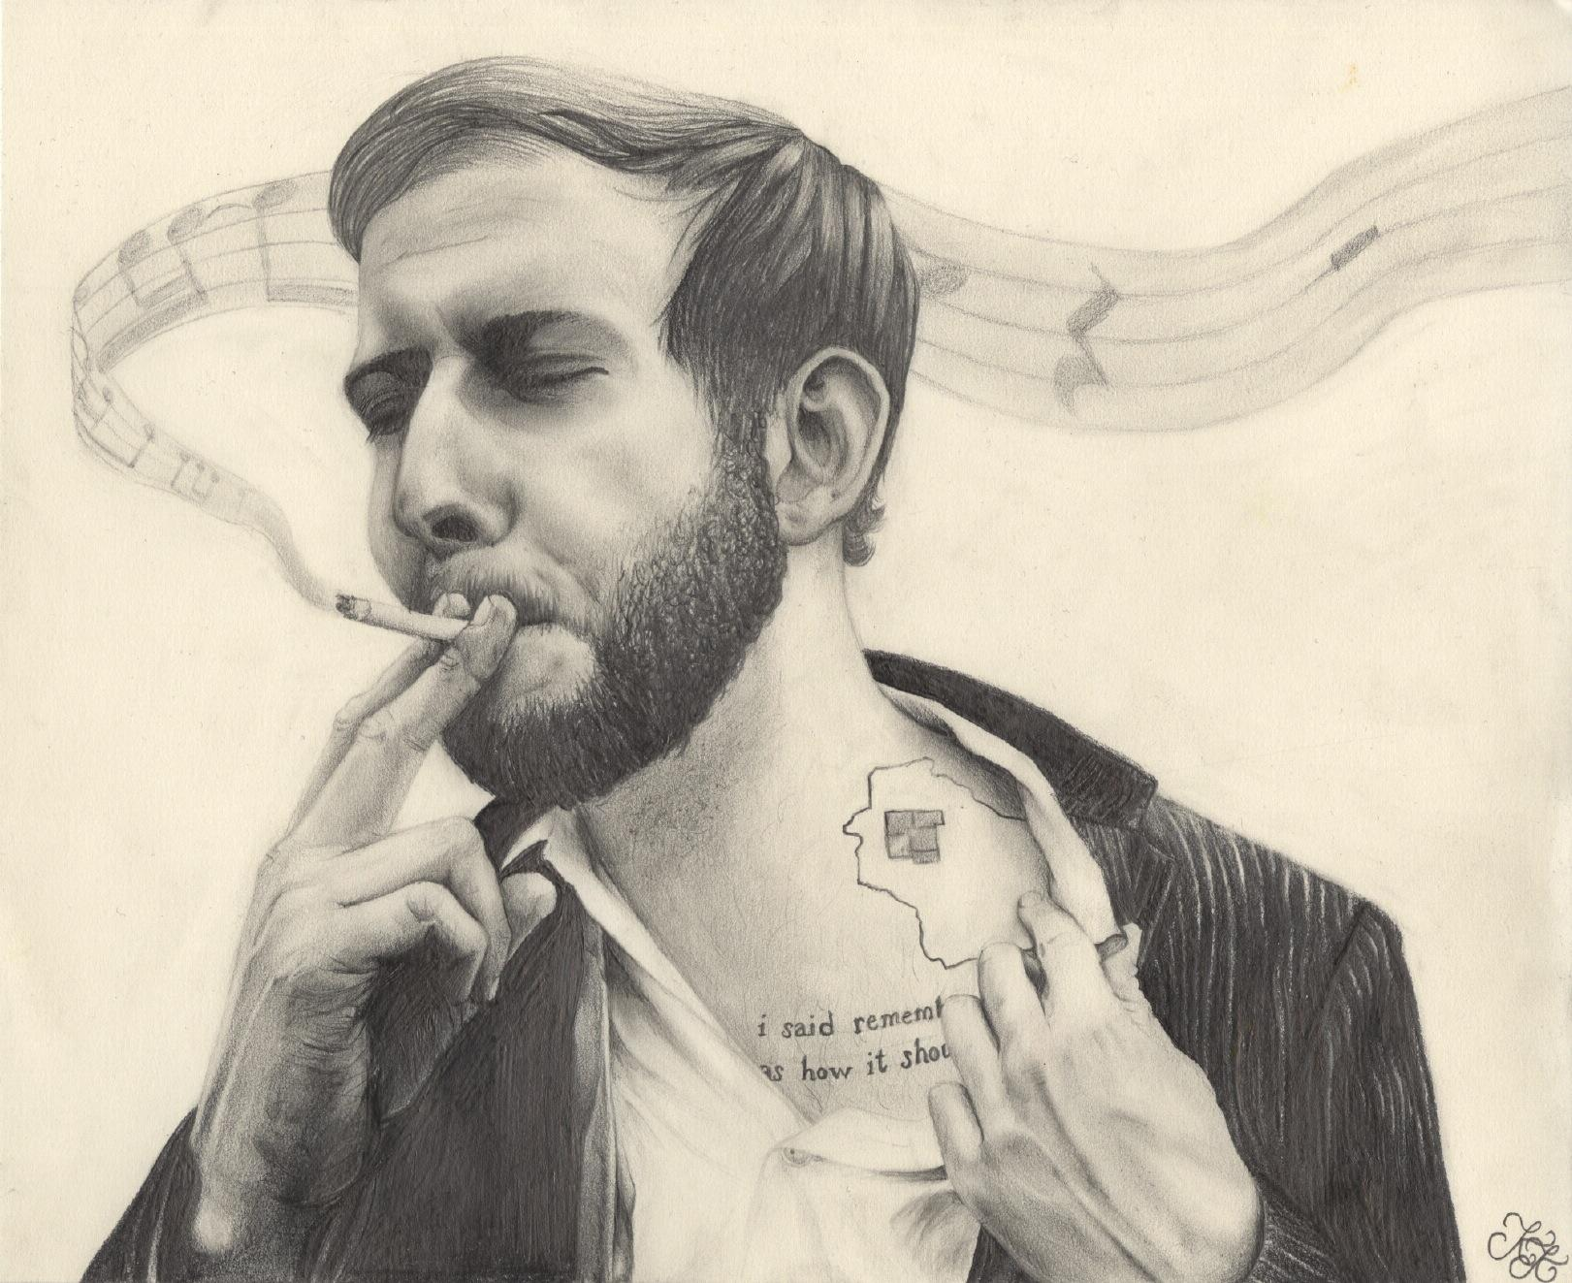
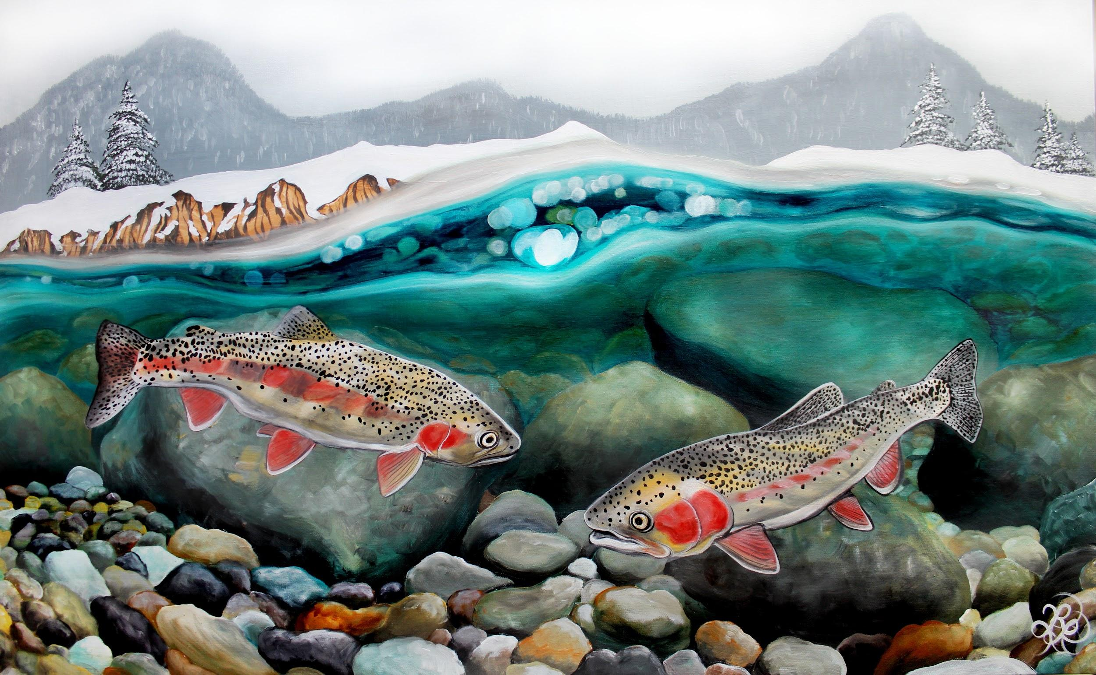

Slide 3
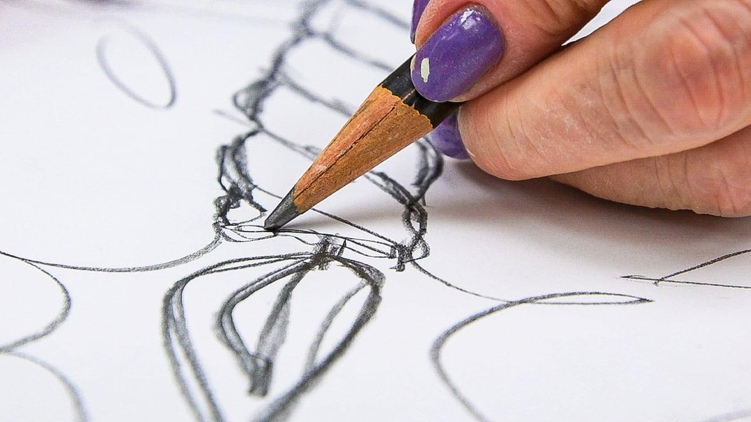
Today’s Goals:
Learn fundamentals of drawing and art
Learn and apply basic drawing techniques and exercises through practice
Explore the loose, fun, and creative side of drawing--release your inhibitions!
Consider personal drawing style and qualities

Slide 4
Notable Principles and Elements of Art:
Line
Value
Perspective
Space
Form
Shape
Size
Proportion
Composition
Focal point(s)
Composition
Contrast
Texture
Movement
Positive and Negative Space
Focal Points
Use swift, flowing sketch lines
Doesn’t need to be exact
ints
Balance
Unity/Harmony
Variety
Gradation
Patterns
Contrast
Color/Hue
Movement
Rhythm
Repetition
Texture
Positive/Negative Space
Content
Concept
Style
Notes:
We are already going to go through some of these
Will go into the ones that we won’t
Value and Perspective we will go into more of in the next class

Slide 5
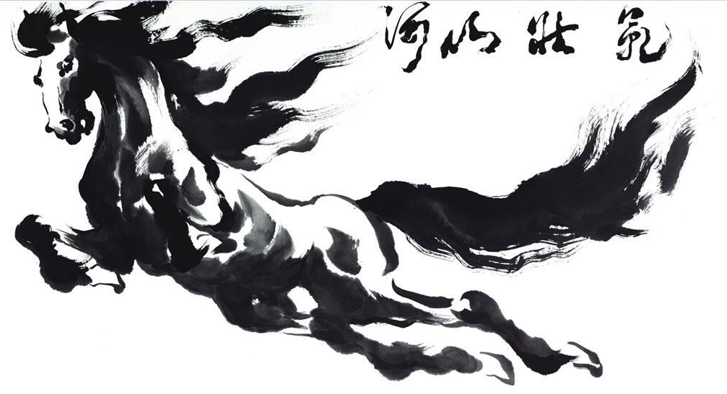
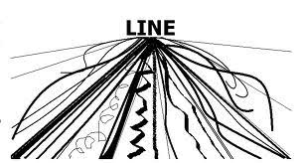
Line
Line - a point moving in space
May be descriptive, implied, or abstract
Line quality/weight can communicate a wide variety of things
Is the line thick or thin? Long or short? Chaotic or peaceful? Soft or harsh? Moving or stagnant?
Notes:
Some are more expressionistic, others are harsher with sharp edges and lines
What is your style?

Slide 6
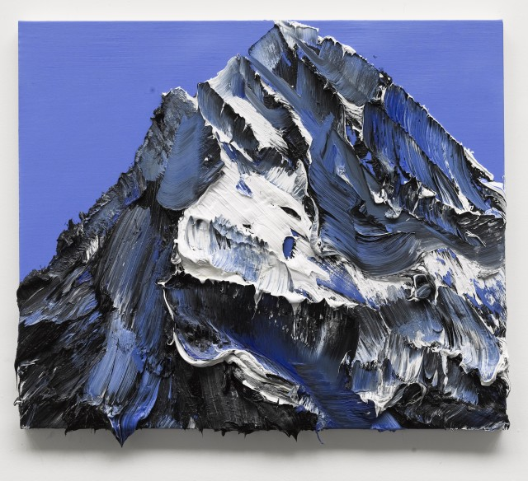
Texture
An element of art that refers to the way things feel, or look as if they might feel if touched
What kind of feelings/sensations do you perceive from the visual texture?
“SOL-30” by Conrad Godly

Slide 7
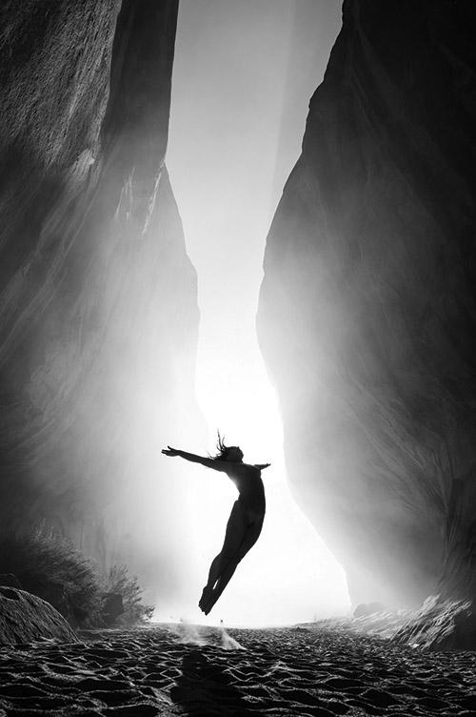

Composition and Focal Points
Composition - the placement or organization of visual elements in a work of art
Focal Point - the area(s) in an artwork where the viewer’s eye is naturally drawn
Good composition makes a huge impact!

Slide 8
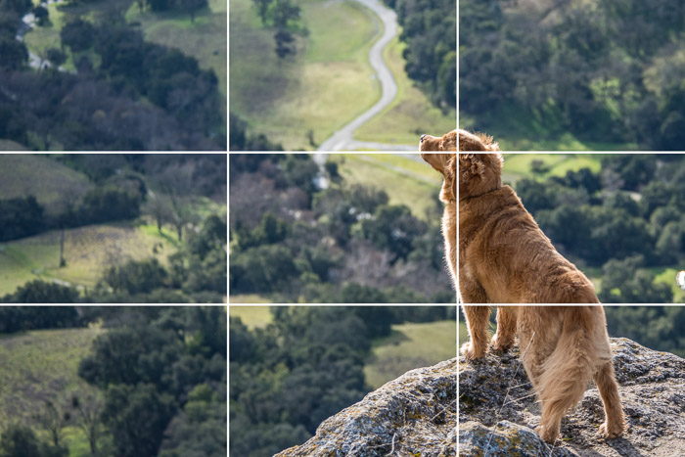
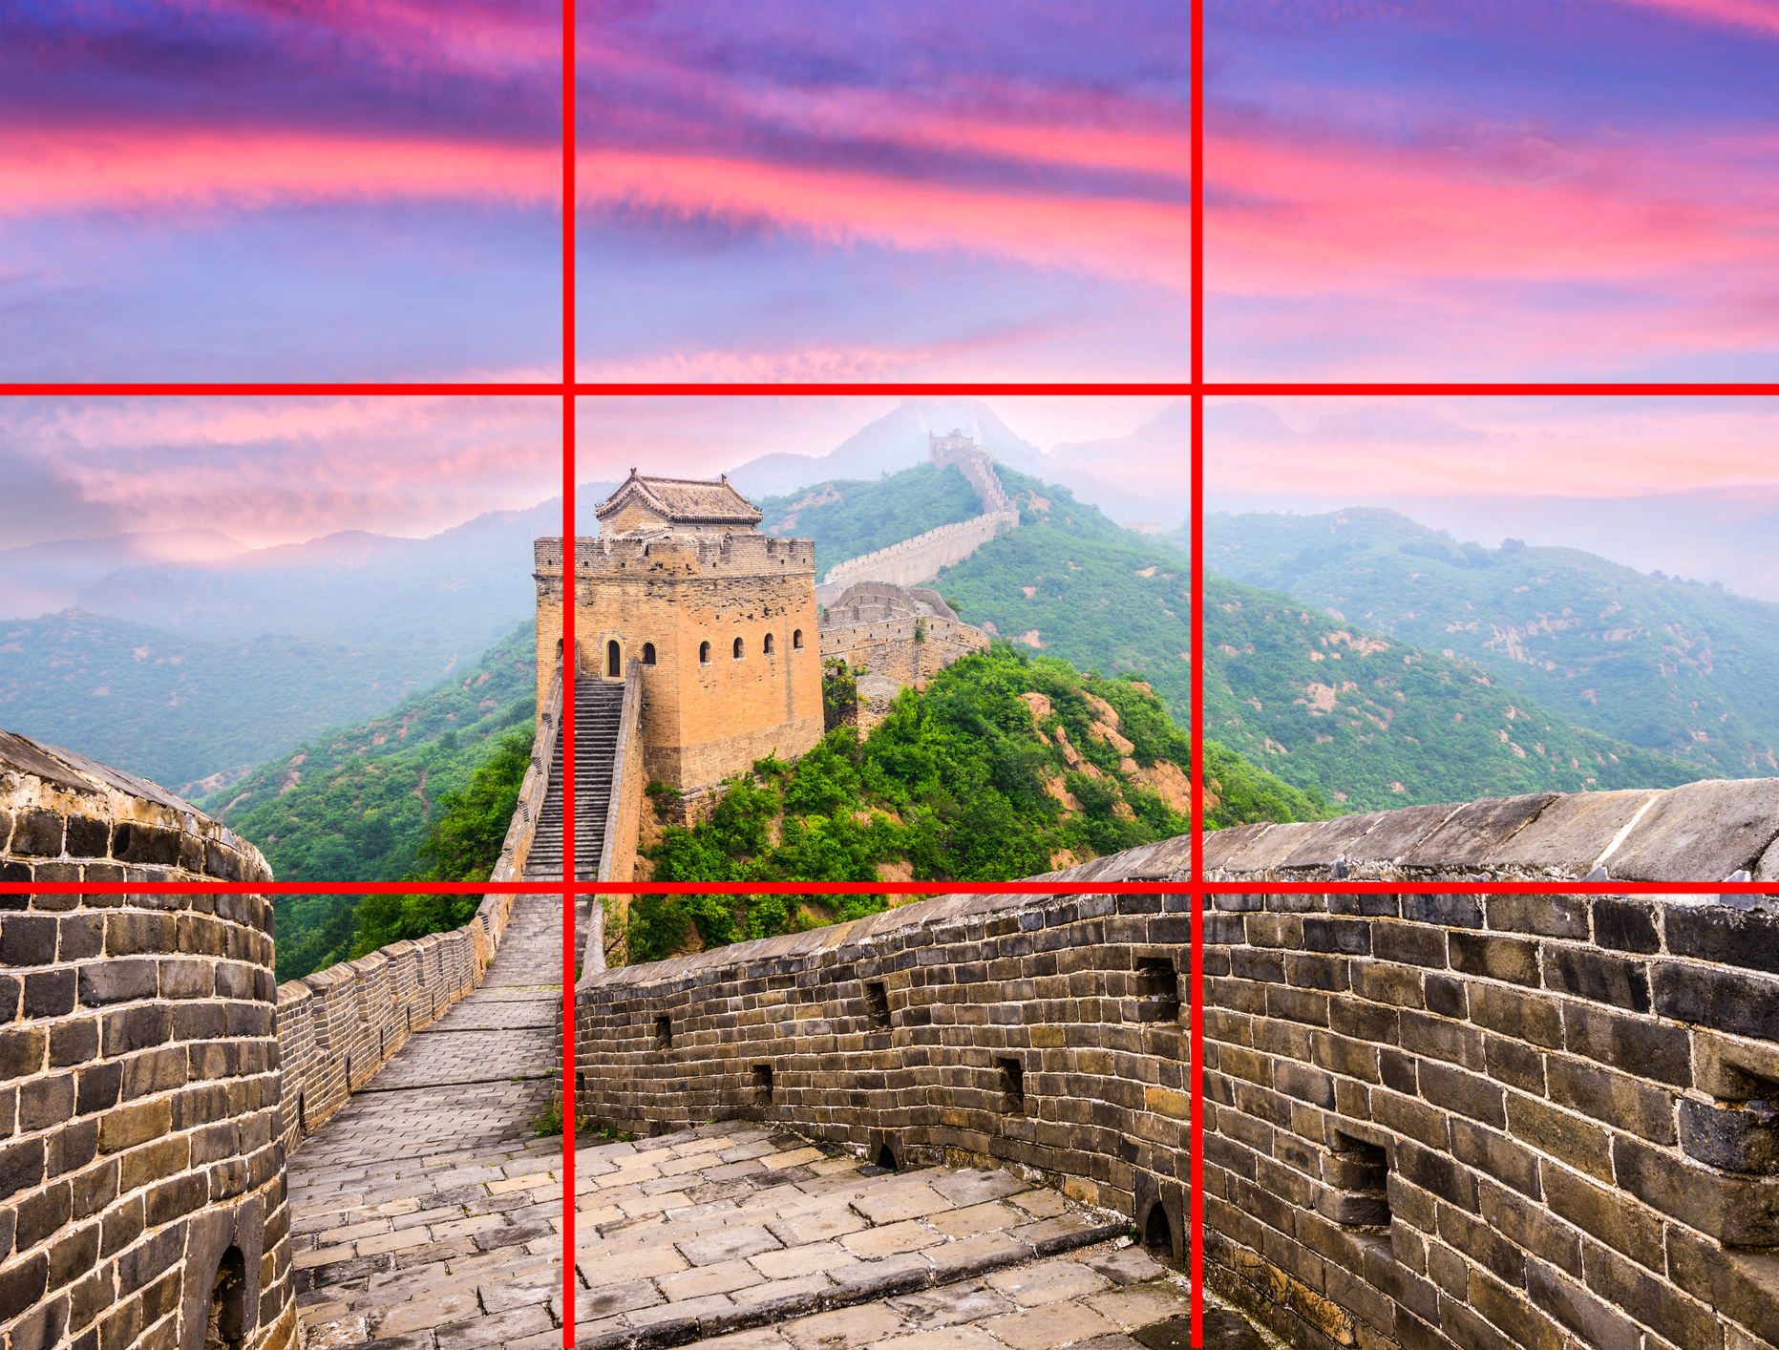
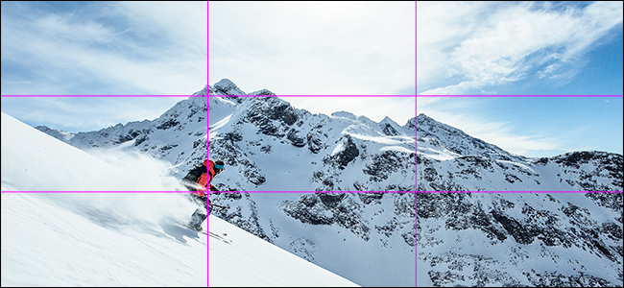
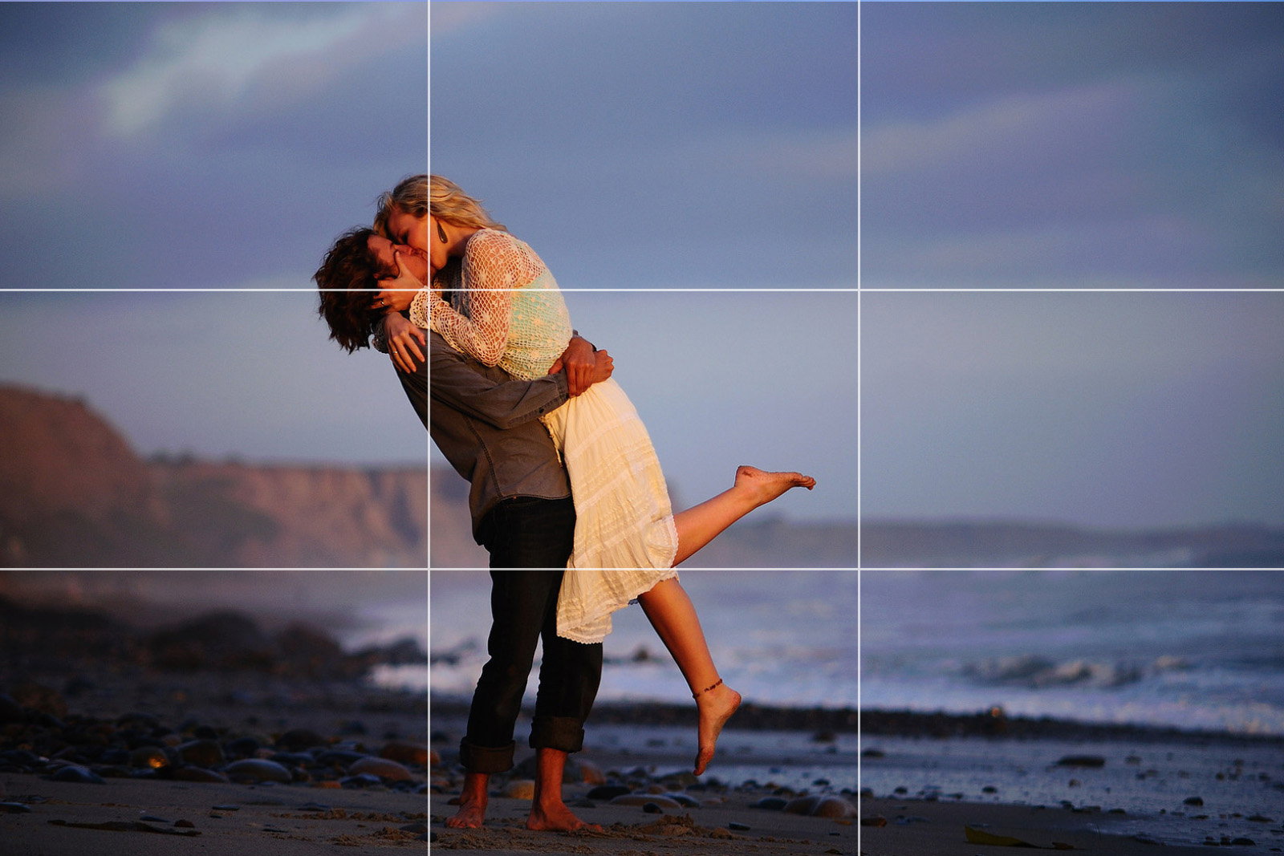
Composition and Focal Points
“Rule of Thirds” - mentally dividing up image using two horizontal lines and two vertical lines, and having focal points lining up with any of the intersecting points
Good composition often involves the “Rule of Thirds” if focal points are not in a centered orientation
Notes:
Some are more expressionistic, others are harsher with sharp edges and lines
What is your style?

Slide 9
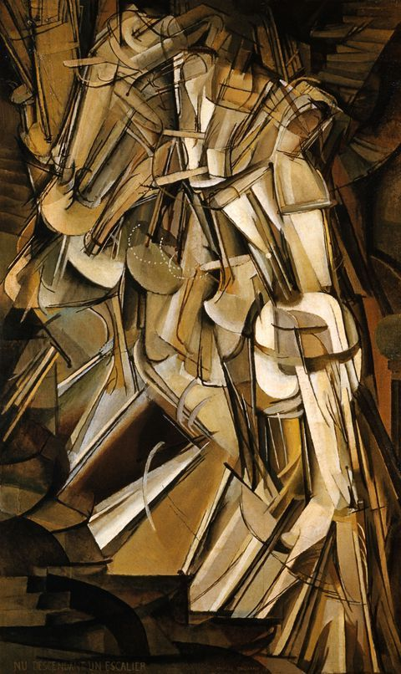
Movement and Rhythm
Movement - creates the look and feeling of action to guide viewer’s eye throughout the work of art
Rhythm - indicates movement, created by the careful placement of repeated elements in a work of art to cause a visual tempo or beat
Is there a sense of direction or flow in the work?
Patterns
Content
Concept
Style
“Nude Descending a Staircase, No. 2” by Marcel Duchamp
Notes:
Some are more expressionistic, others are harsher with sharp edges and lines
What is your style?

Slide 10
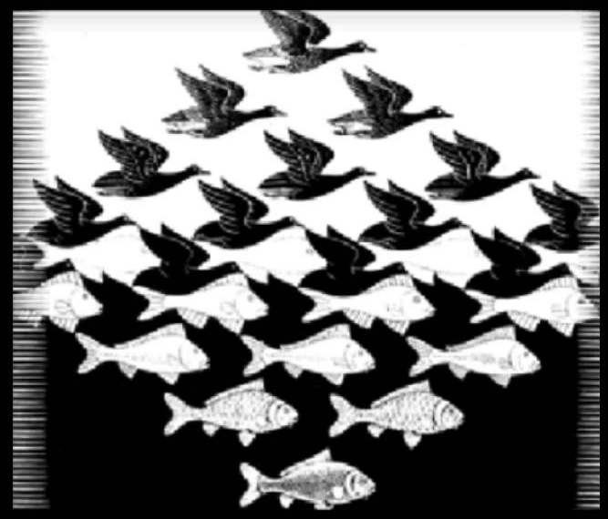

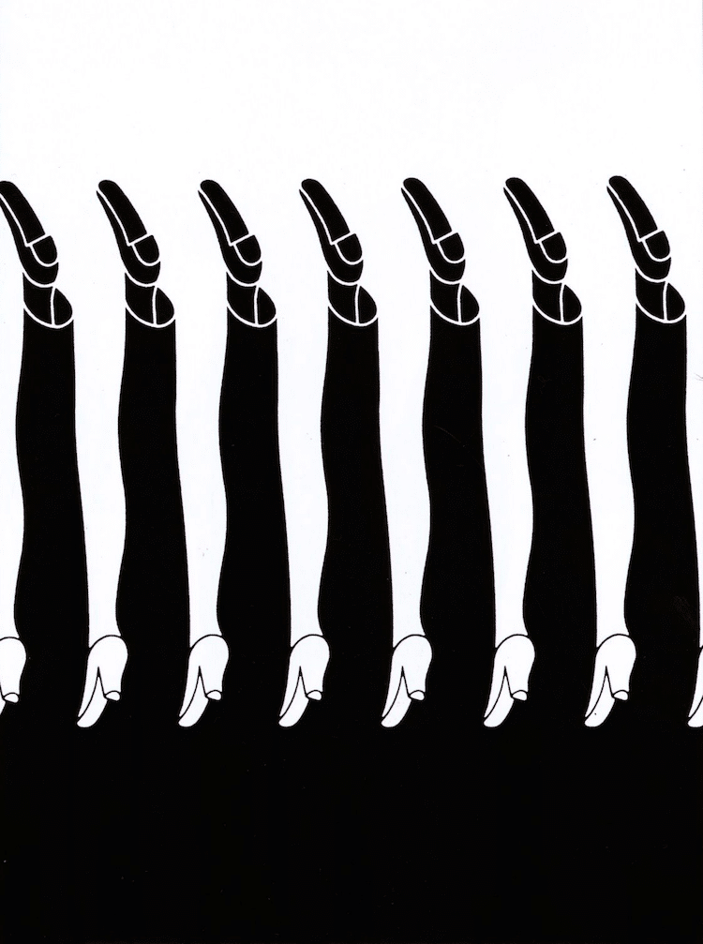

Positive & Negative Space
Positive space refers to the main focus of the picture
Negative space refers to the background
Is it clear in the artwork what is the positive space and what’s the negative space?
Notes:
These are all examples of artworks where the positive and negative space are ambiguous
These images are also good examples of the visual elements of patterns and repetition

Slide 11
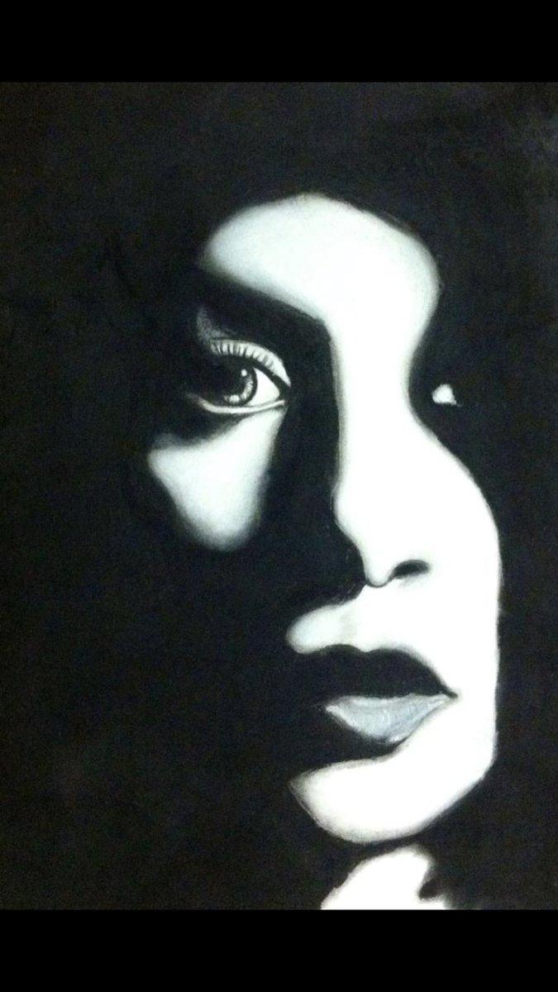
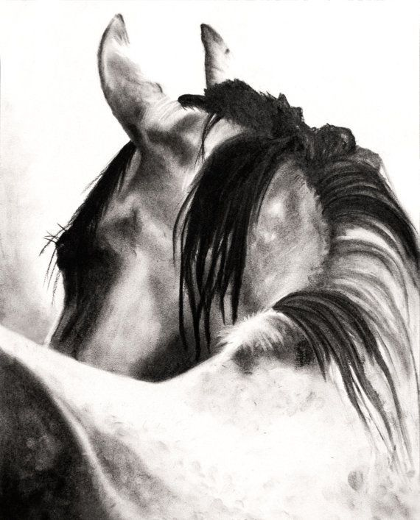
Contrast
Contrast - refers to the arrangement of opposite elements in a piece so as to create visual interest, excitement, and drama
More contrast in value means less midtone, and more shadows/highlights

Slide 12
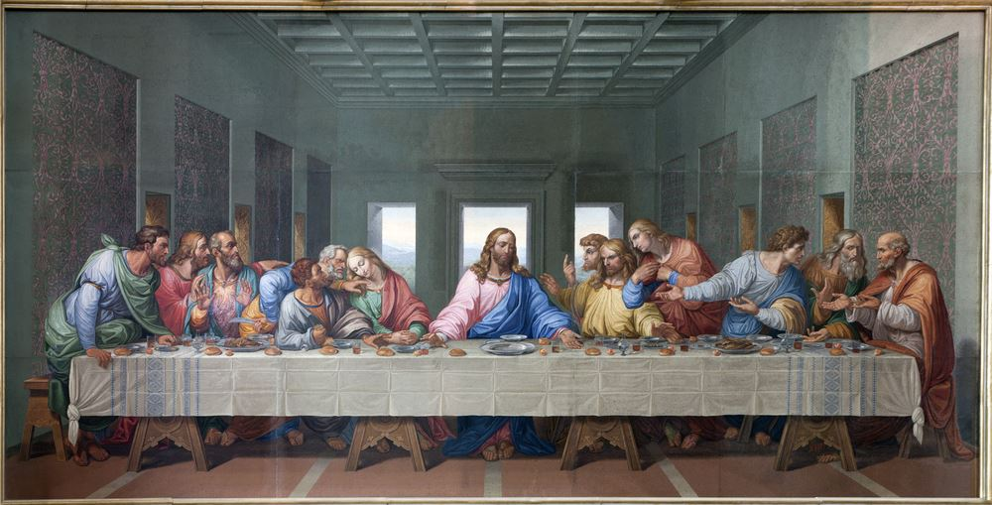
Balance and Unity
Balance - refers to equalizing visual forces or elements in a work of art; distribution of visual weight
Unity - gives the artwork a sense of cohesion or coherence
Are the elements in the artwork arranged in a satisfying way?
Does the artwork look whole and complete?
“The Last Supper” by Leonardo da Vinci
Notes:
These are all examples of artworks where the positive and negative space are ambiguous

Slide 13
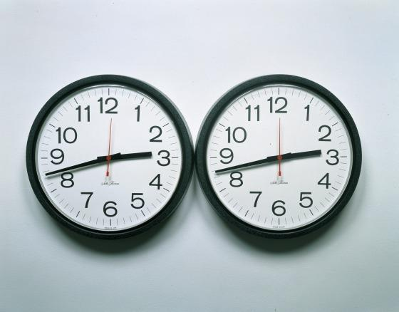
Content and Concept:
Content - refers to what is being depicted in the artwork
What is the artwork about?
Is the subject matter visually clear?
Is the intended message visually clear?
“Untitled (Perfect Lovers)” by Félix González-Torres
Notes:
Can anyone guess what this artwork is about?
This is why I personally appreciate when art museums have descriptions about the work, so you can know and appreciate what the artist’s intentions were if it isn’t clear

Slide 14
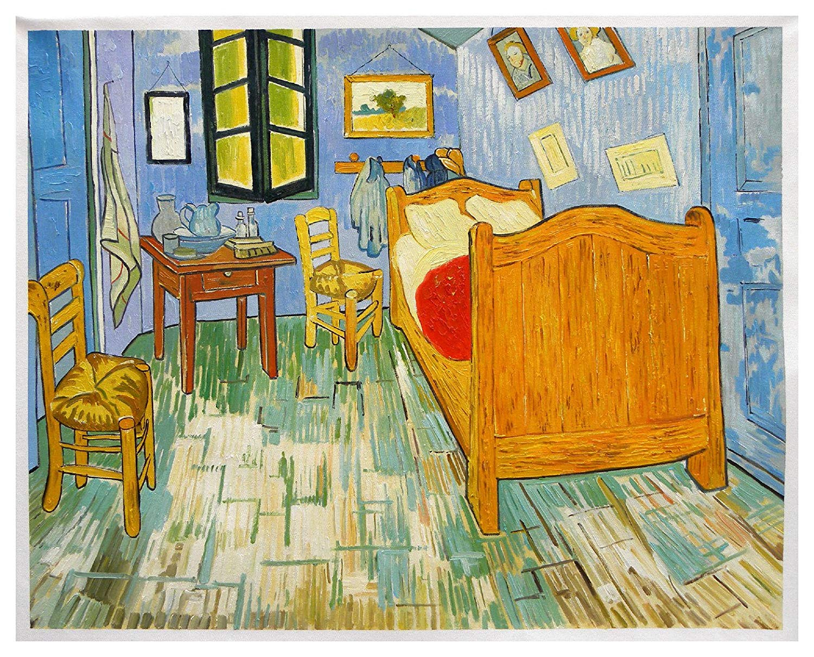
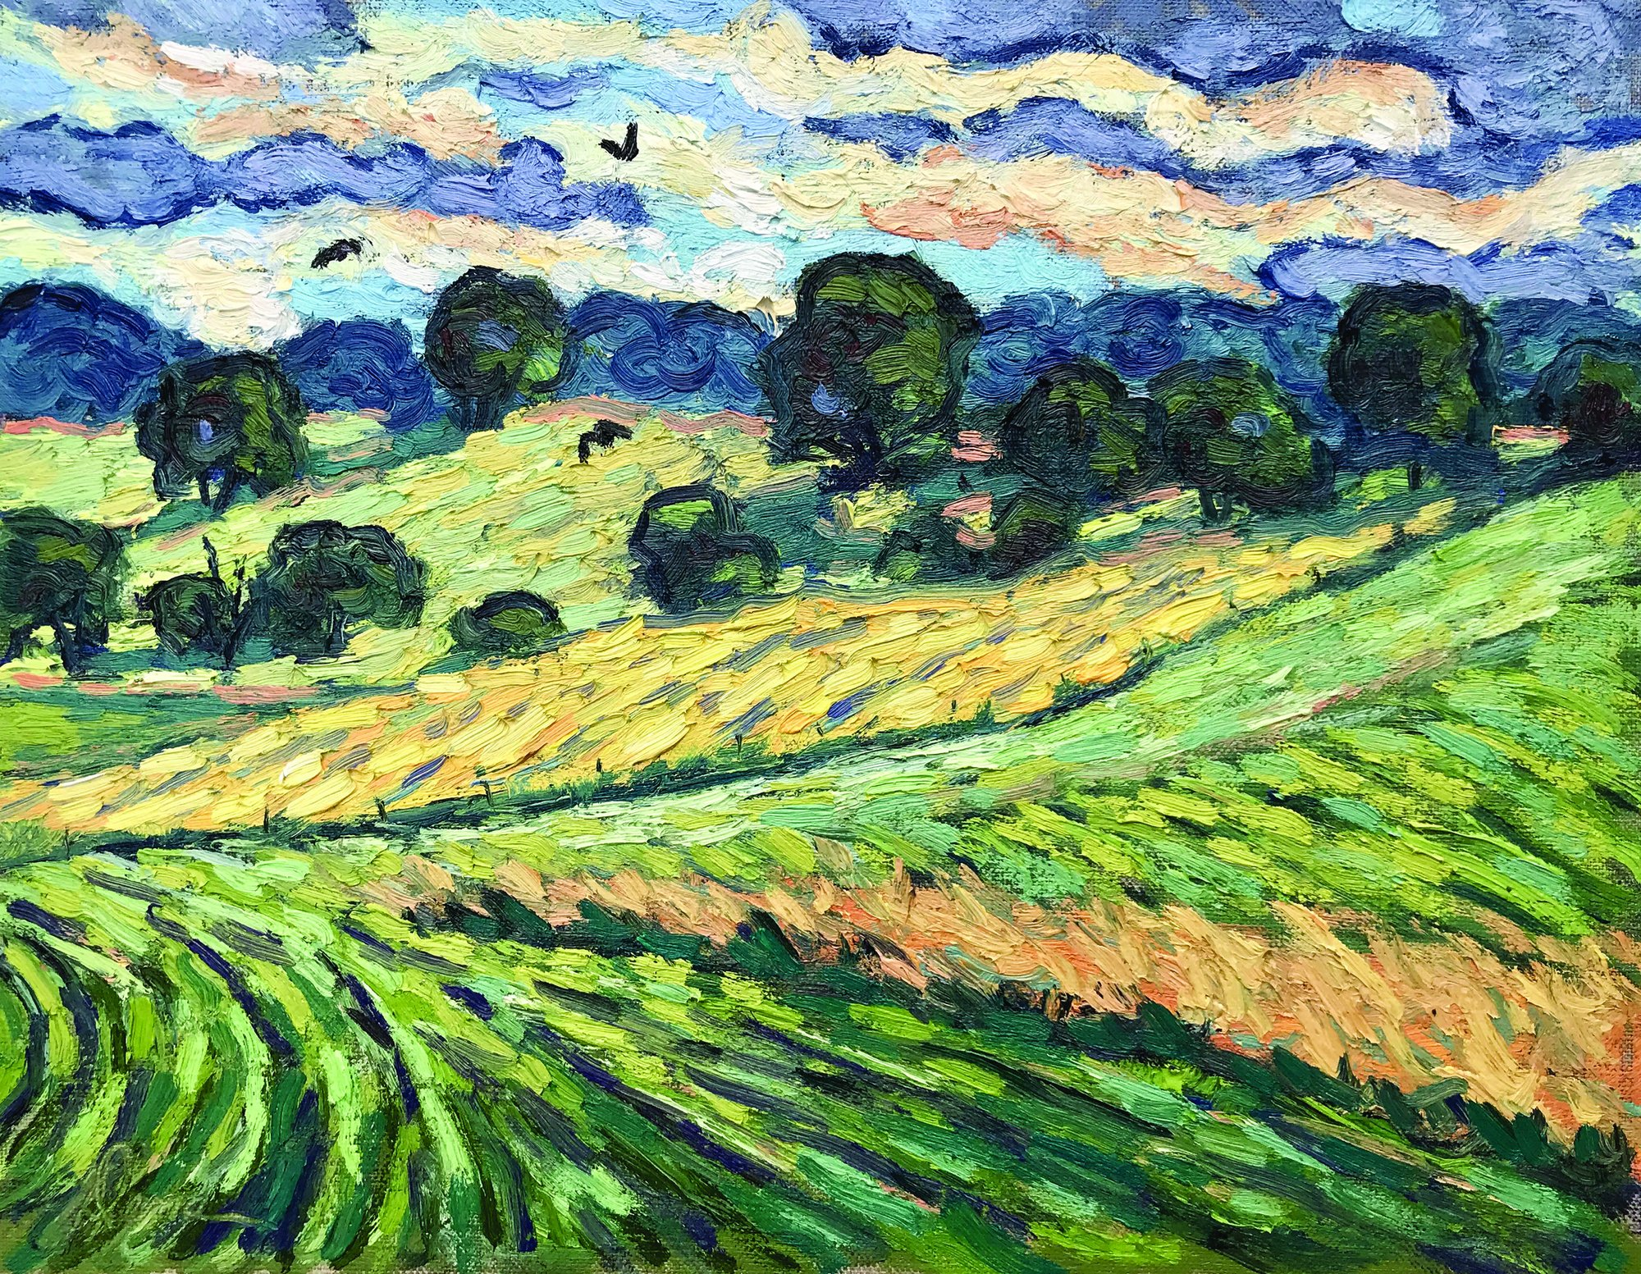
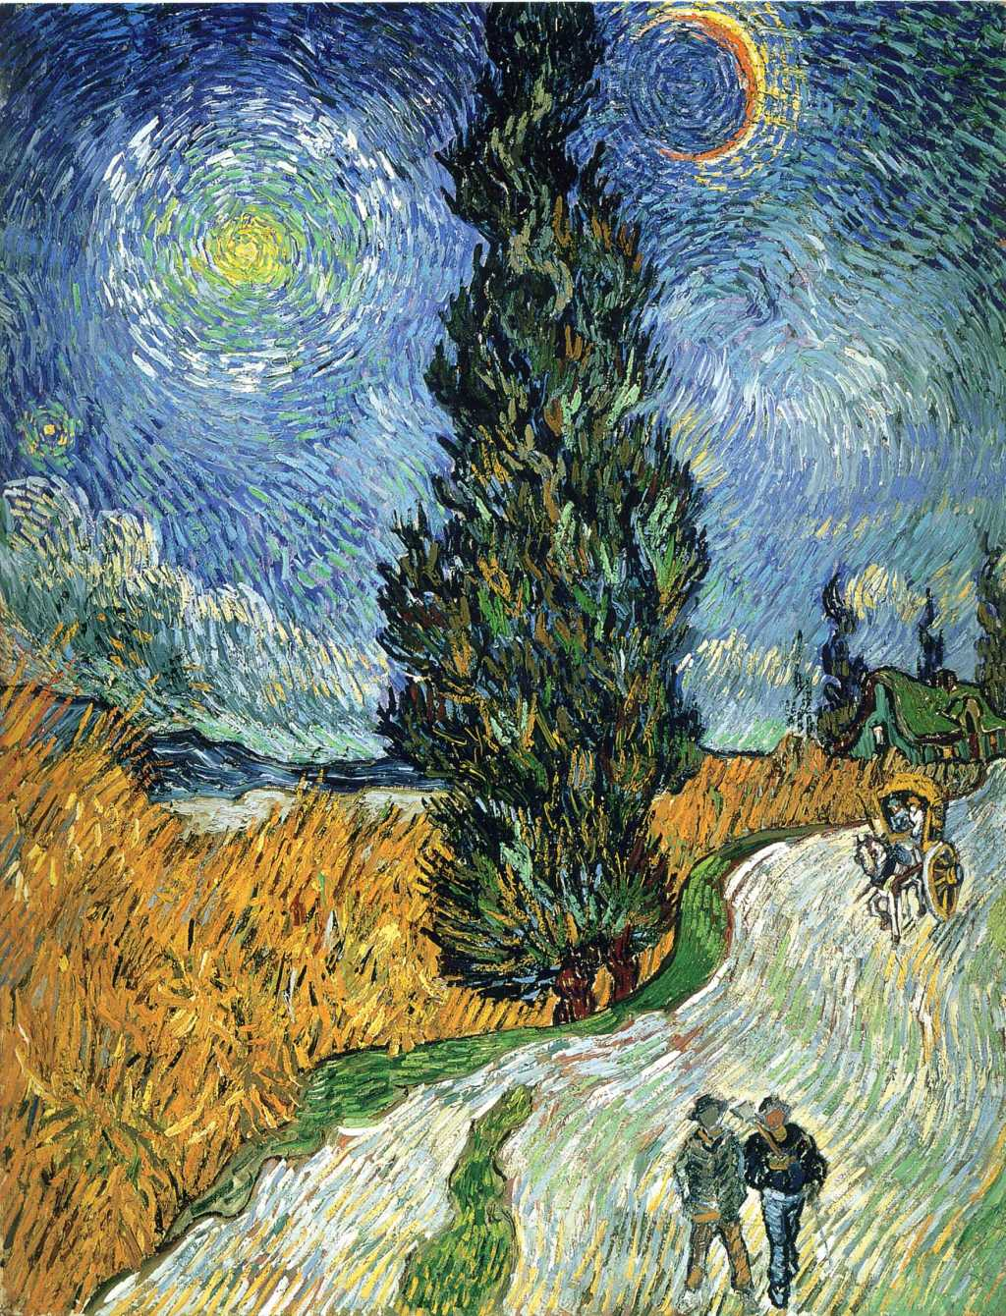
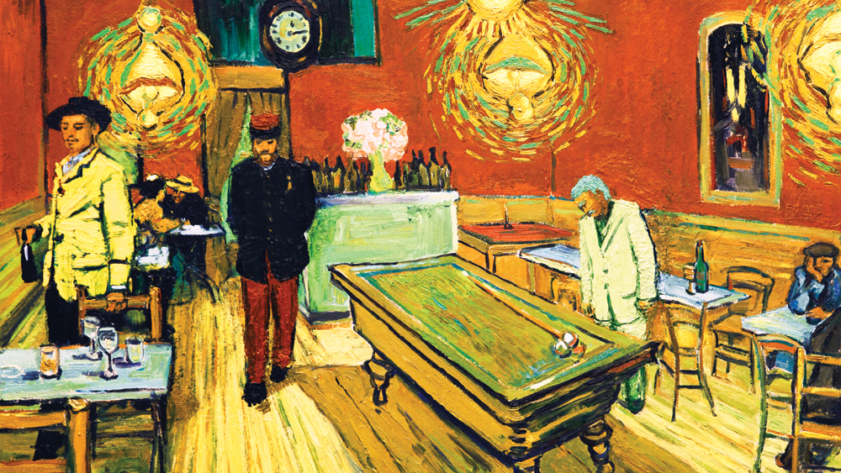
Style
The way in which an artist expresses their work
In other words, a “visual signature”
What does the style say about the artist? Is it recognizable and distinct?
Style can also refer to that of art movements; ex. - Impressionism, Cubanism
Notes:
Can anyone recognize the artist of these artworks?

Slide 15
Drawing Techniques
Shading, Sketching, and Form

Slide 16
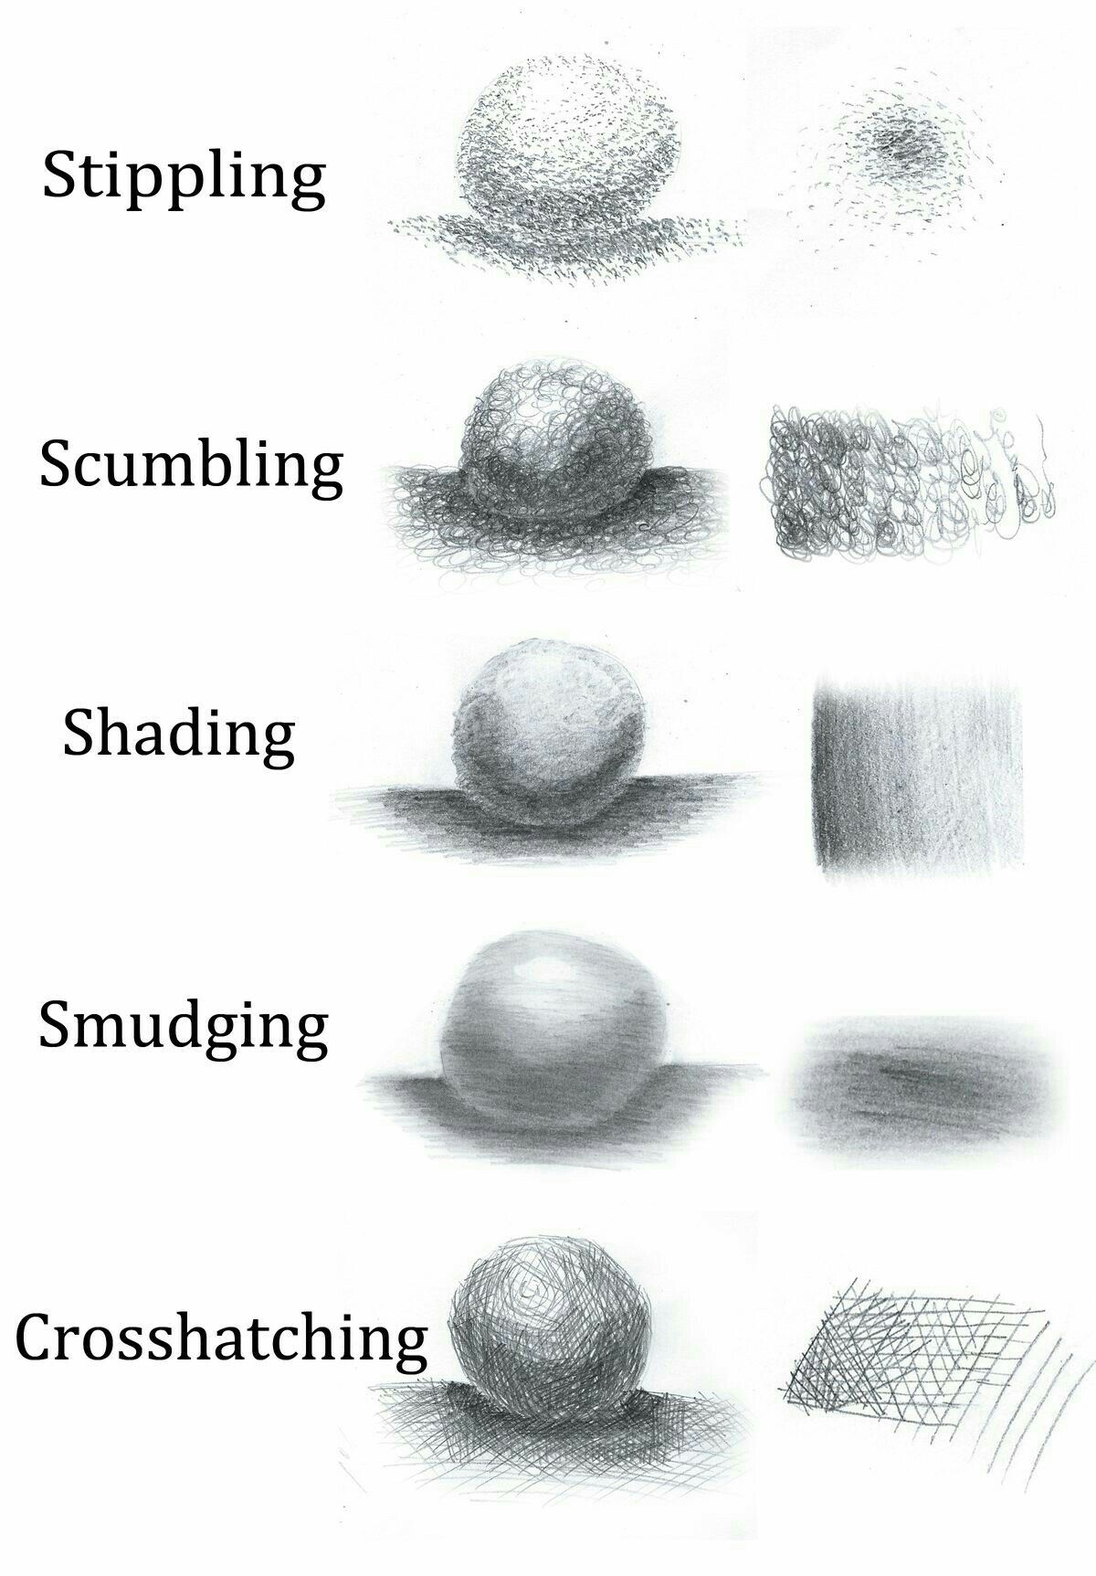
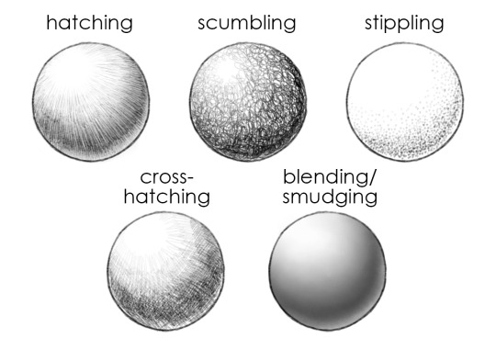
Shading Techniques

Slide 17
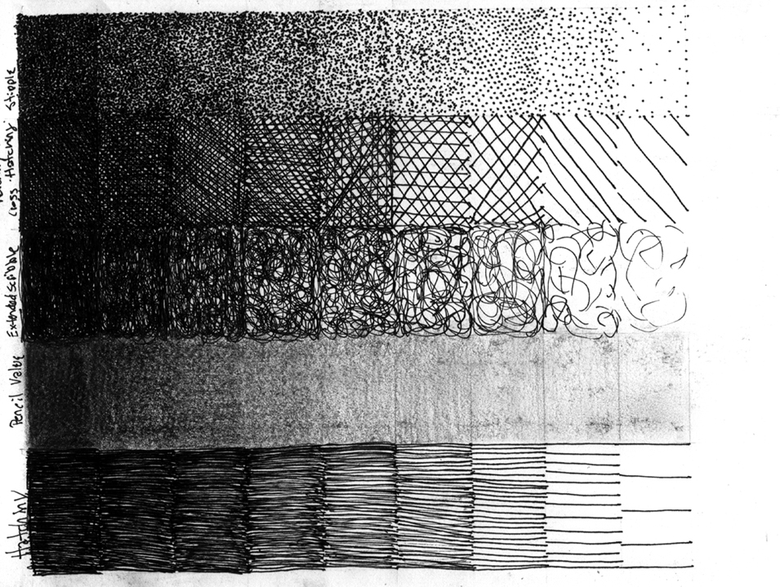
Tonal Keys
Gradient with lightest shade on one end, darkest on the other
A helpful practice to assess all the different shades you can achieve
Feel free to try this on your own!
Notes:
This is a common practice in beginning drawing
I want to focus on other things for this class, so we won’t have time to do this
But feel free to try it out on your own!

Slide 18
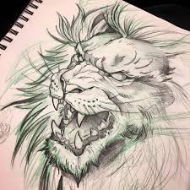
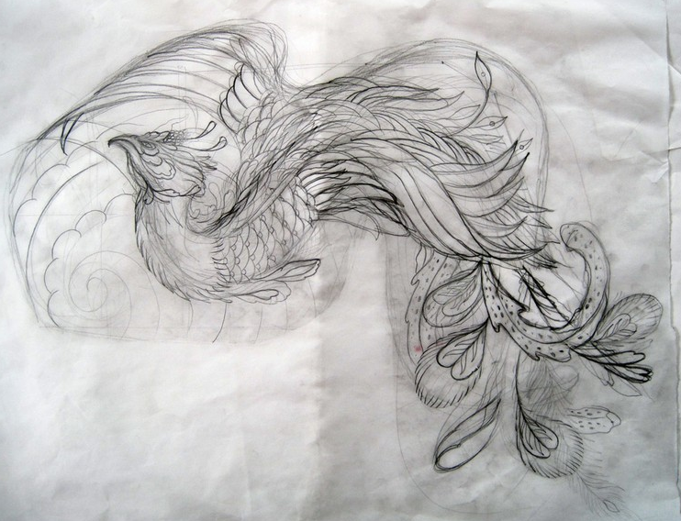
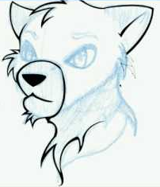
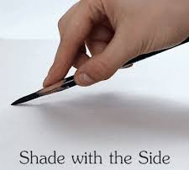
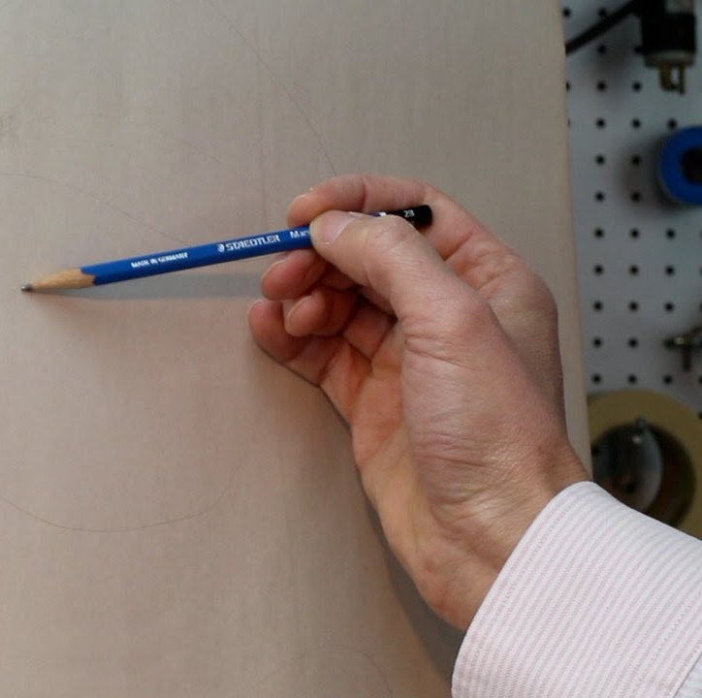
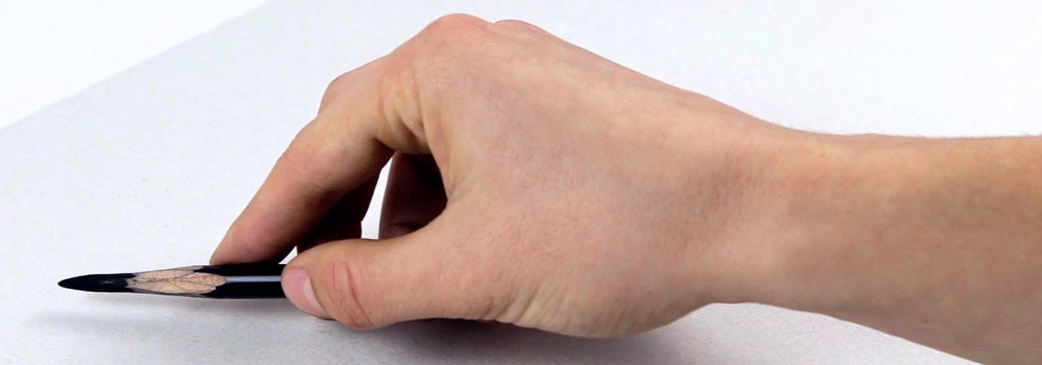
Sketching Tips
Hold pencil loosely in hand, press lightly
Don’t be afraid to be incorrect; draw lightly until it’s correct
When lines are proportional, darken them slightly
Can use one light color for sketching first, and a darker color for dark lines after
Notes:
I think of tattoo artists when they sketch
Sometimes they use multiple colors to sketch, with the initial color being light and the final color being darker

Slide 19
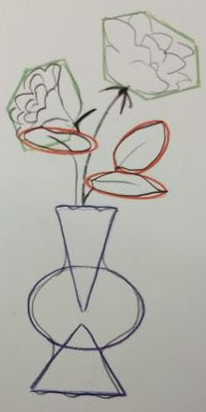
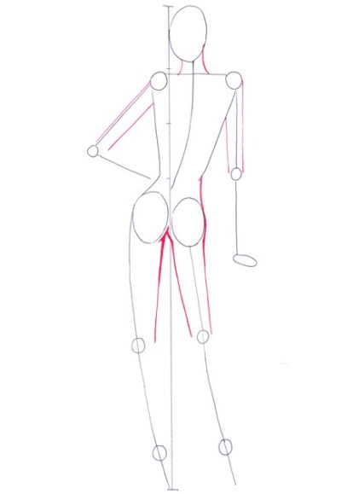
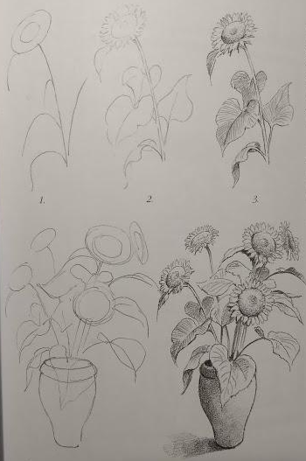
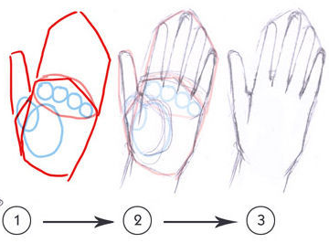
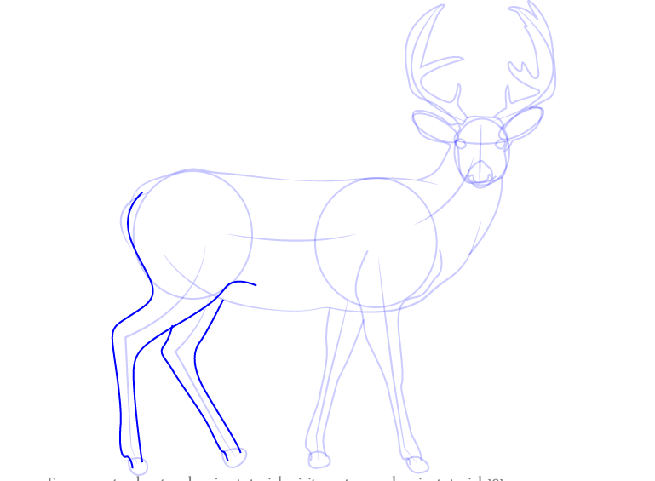
Form
Start outline by using basic shapes
Refine the basic shapes with more detail and intricate lines and curves
Double-check your proportion
Erase gestural lines (if necessary)

Slide 20
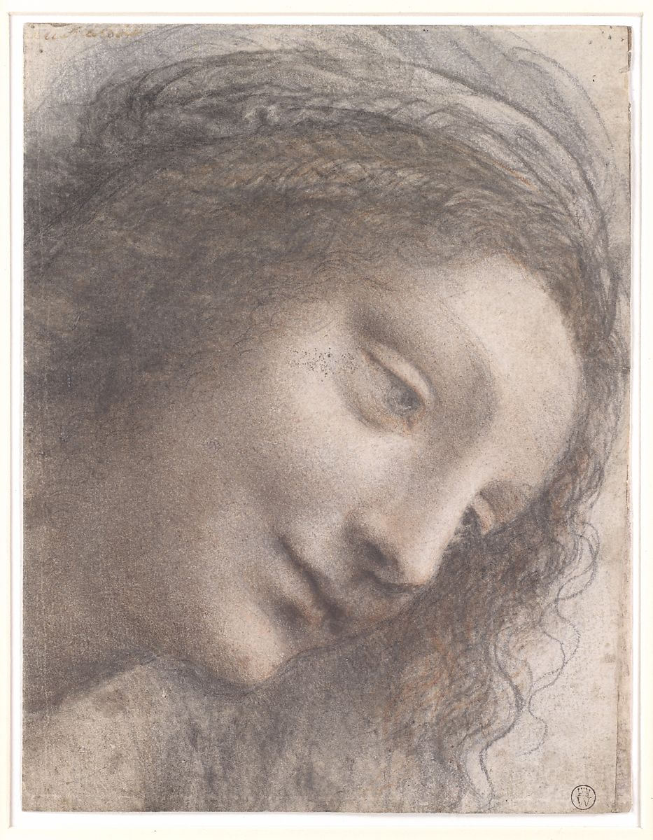
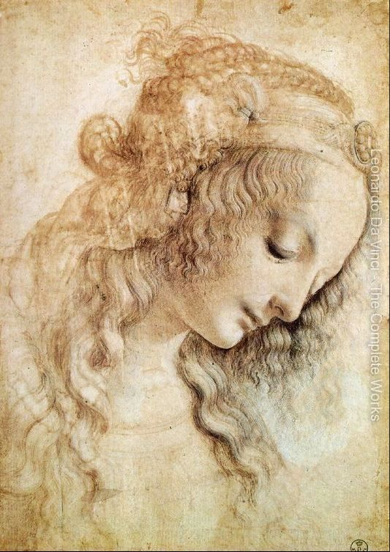
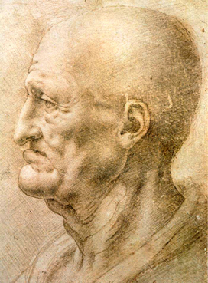
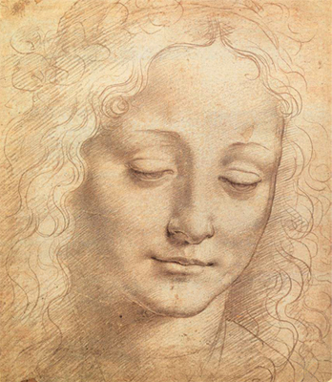
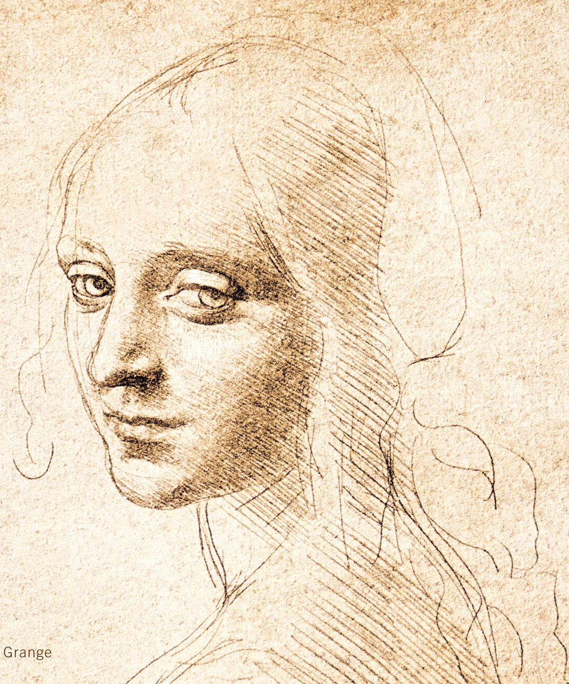
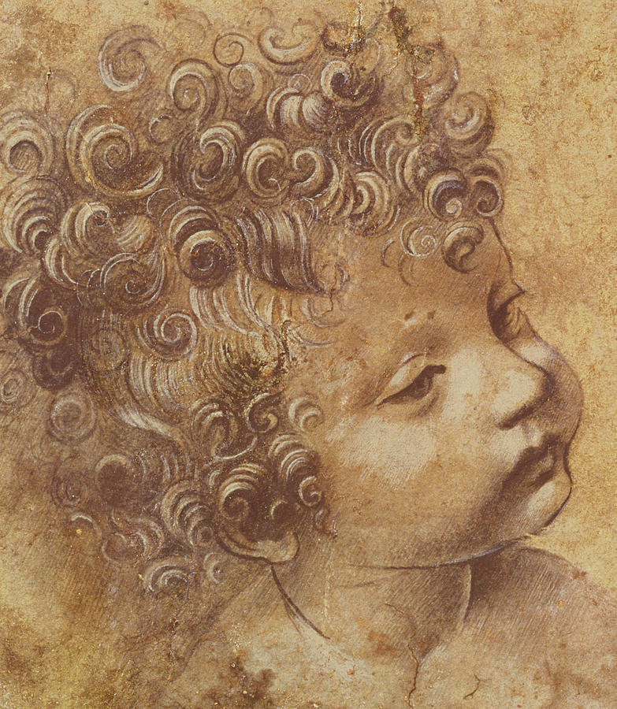
Leonardo’s Drawing
Technique
“Sfumato” -- prominently used by da Vinci
  Italian for “smoke”
  Technique of achieving a smoke-like effect with soft transitions
  Product is very realistic and accentuates life-like effect
Notes:
But I’ll leave it to the expert to teach you the rest about Leonardo ;)

Slide 21
Drawing Exercises
There’s more than one way to draw!

Slide 22
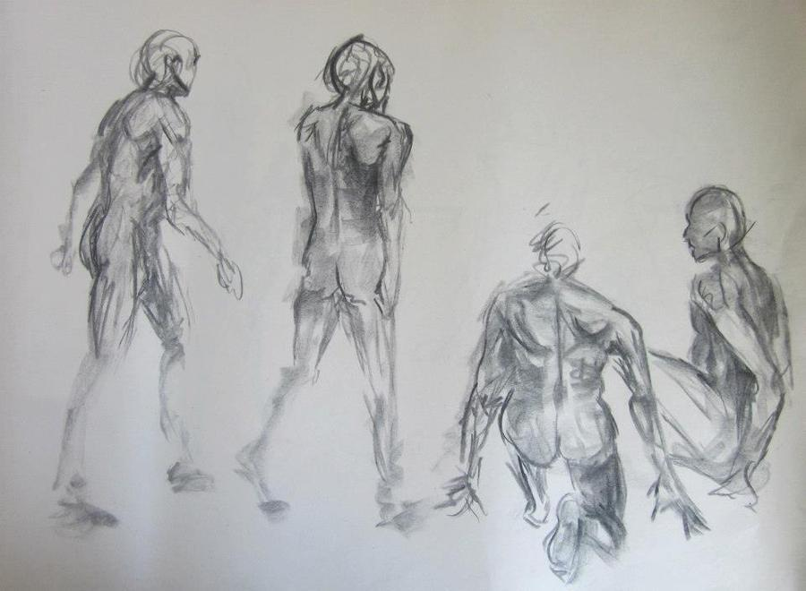
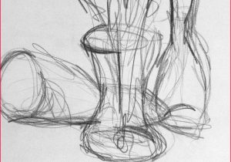
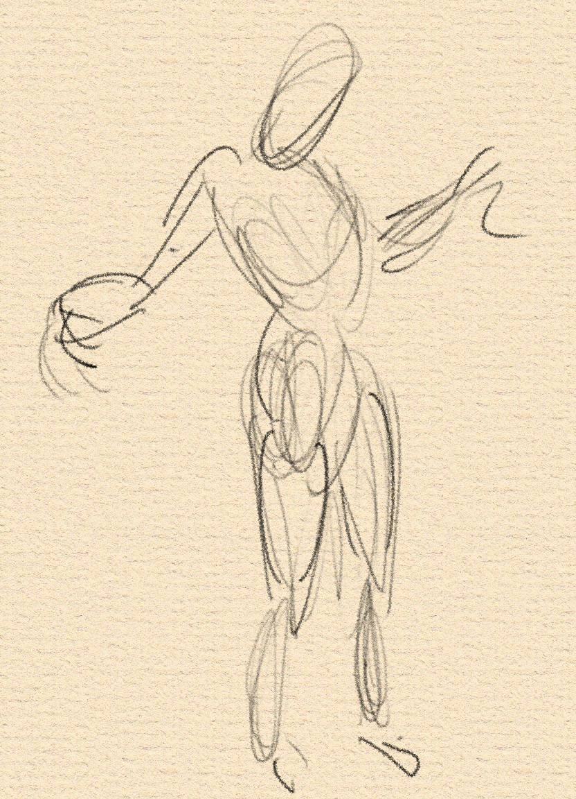

Gesture
Capture essence of image
Use swift, flowing sketch lines
Doesn’t need to be exact
Many different ways to do gesture
What’s your style?
Notes:
Some are more expressionistic, others are harsher with sharp edges and lines
What is your style?

Slide 23





Blind Contour
One single line
Captures outline with important details
Artist looks at the subject the entire duration of the drawing--no looking at the paper

Slide 24




Opposite Hand
Drawing with non-dominant hand challenges your brain
Product is often more abstracted compared to drawing with dominant hand

Slide 25

Upside Down
“This exercise is designed to reduce conflict between brain modes by causing your language mode to drop out of the task. Presumably, the language mode, confused and blocked by the unfamiliar upside-down image, becomes unable to name and symbolize as usual. In effect, it seems to say, I don’t do upside down, and allows the visual mode to take over.” - Betty Edwards Drawing on the Right Side of the Brain
Pablo Picasso (1881-1973), Portrait of Igor Stravinsky. Paris, 1920.

Slide 26





Line Drawing
No shading, just lines
Lines are realistic and proportional
Mainly outlines with some lines to include important detail

Slide 27





Value Drawing
Uses various shading techniques
Explores the range of shadows, midtones, and highlights
Creates three-dimensional illusion

Slide 28
Drawing Exercises
Now it’s your turn to try!
Challenge your brain and sense of perception!

Slide 29

Drawing Exercises
Beloved Mr. Rogers will be our drawing reference today!
Only minutes for each exercises--plan your time wisely
Using the same image in the exercises will clarify and accentuate the differences between the styles
Intention for this is for you to leave with tangible examples of different drawing styles
Notes:
Drawing people is challenging, and I want to challenge you all
I will show you examples of my version of the same exercises for comparison

Slide 30
Drawing Exercises
Don’t worry if your drawing isn’t what you intended, that’s a part of the process!
Be loose with your drawing, have fun
I will show you examples of my version of the same exercises for comparison
Notes:
Drawing people is challenging, and I want to challenge you all
I will show you examples of my version of the same exercises for comparison

Slide 31
Drawing Exercises
Once you’ve completed all the drawings, look at the differences between them
How did your hand and perception change with each exercise?
What did you enjoy about the exercises?
What is your style? What do you excel in?
Notes:
Drawing people is challenging, and I want to challenge you all
I will show you examples of my version of the same exercises for comparison

Slide 32
Gesture
Time: 3 Minutes
Use swift, flowing sketch lines
Capture essence of image
Doesn’t need to be exact

Slide 33

Karen’s Gesture Drawing
Time: 3 Minutes
Use swift, flowing sketch lines
Capture essence of image
Doesn’t need to be exact

Slide 34
Blind Contour
Time: 1 Minute
One single line
Include all major details
Do not look at your paper as you draw!

Slide 35

Karen’s Blind Contour
Time: 1 Minute
One single line
Include all major details
Do not look at your paper as you draw!

Slide 36
Opposite Hand
Time: 5 Minutes
Use your non dominant hand to do a sketch
(You can look at your paper ;) )

Slide 37

Opposite Hand
Time: 5 Minutes
Use your non dominant hand to do a quick sketch
(You can look at your paper ;) )

Slide 38
Upside Down
Time: 5 Minutes
Focus on the lines and shapes that you see
(You can use your dominant hand ;) )

Slide 39

Karen’ Upside Down Drawing
Time: 5 Minutes
Focus on the lines and shapes that you see
(You can use your dominant hand ;) )

Slide 40
Karen’s Upside Down Drawing
Time: 5 Minutes
Focus on the lines and shapes that you see
(You can use your dominant hand ;) )
Look at the drawing right-side up, and compare to your other drawings!

Slide 41
Line Drawing
Time: 15 Minutes
No shading, just lines
Take time to get realistic lines
Focus on what you see, not on what you assume

Slide 42

Line Drawing
Time: 15 Minutes
No shading, just lines
Take time to get realistic lines
Focus on what you see, not on what you assume

Slide 43
Value Drawing
Time: 15 Minutes
Draw line through half of line drawing, apply value on right side of drawing
Use any one of the previously mentioned shading techniques
Observe different tonalities
What are your darkest and lightest shades?

Slide 44

Value Drawing
Time: 15 Minutes
Draw line through half of line drawing, apply value on right side of drawing
Use any one of the previously mentioned shading techniques
Observe different tonalities
What are your darkest and lightest shades?

Slide 45




Drawing Class #2
One long, detailed, realistic value drawing of a still life!
Use charcoal and conté on toned paper
Please bring your own binder/clipboard/textbook/hard surface to draw on
See you next week! :)

