Slide 1
Drawing Class #2!
Presented by Karen Kliethermes
Please take one supply bag at the front! :)

Slide 2

Today’s Goals:
Learn more about value in theory and in practice
Experience using professional drawing supplies
Test your skills at representational art; put what you see to surface
Explore your unique style--what do you excel at?

Slide 3
Quick Recap
Shading, Sketching, and Form

Slide 4
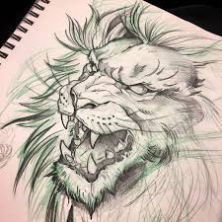
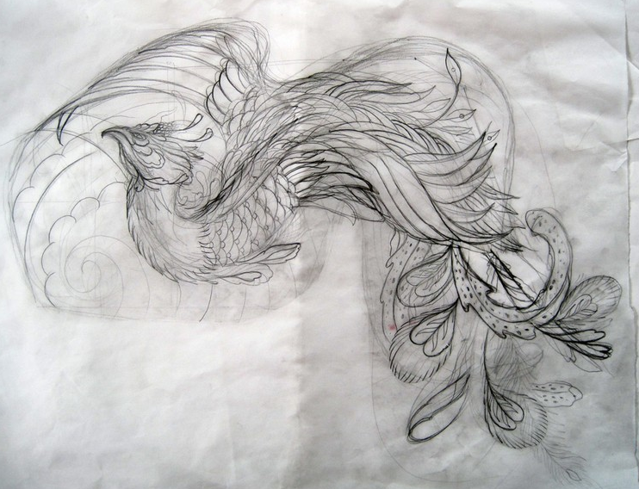
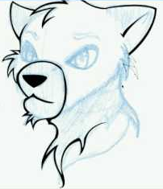
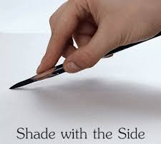
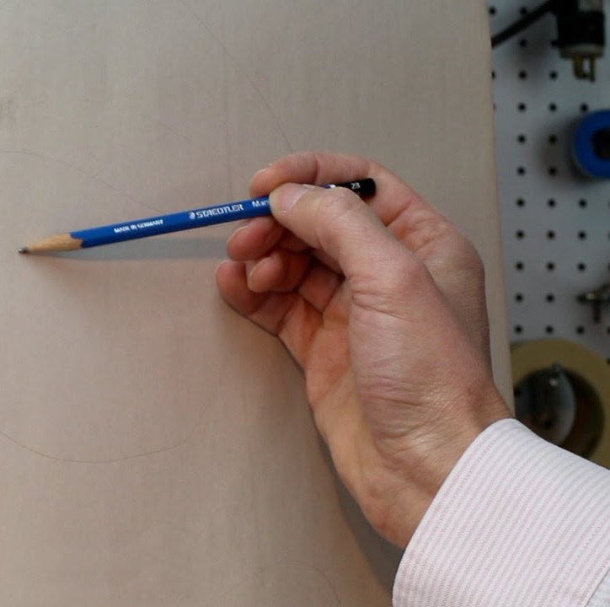
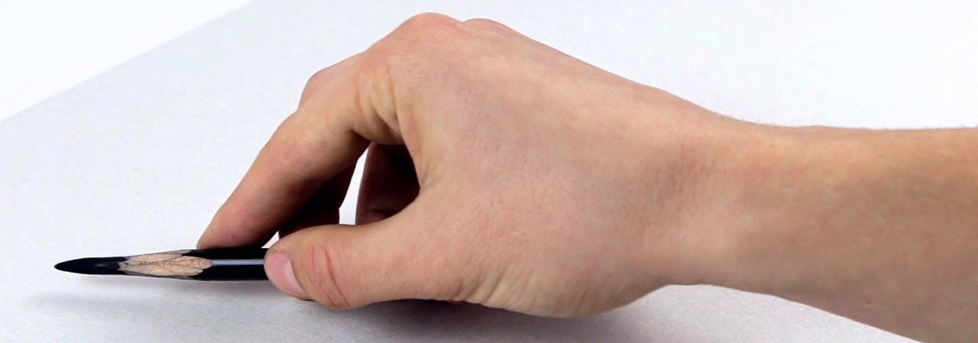
Sketching Tips
Hold utensil loosely in hand, press lightly
Don’t be afraid to be incorrect; draw lightly until it’s correct
When lines are proportional, darken them slightly
Can use one light color for sketching first, and a darker color for dark lines after

Slide 5
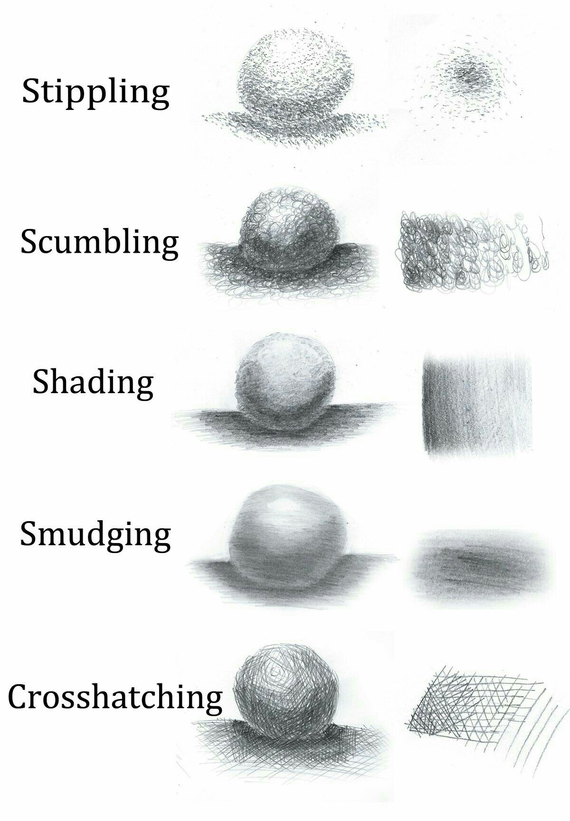
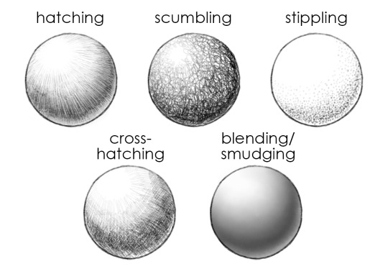
Shading Techniques

Slide 6
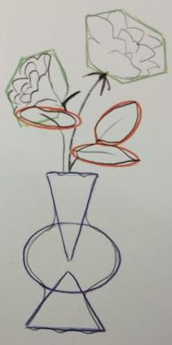
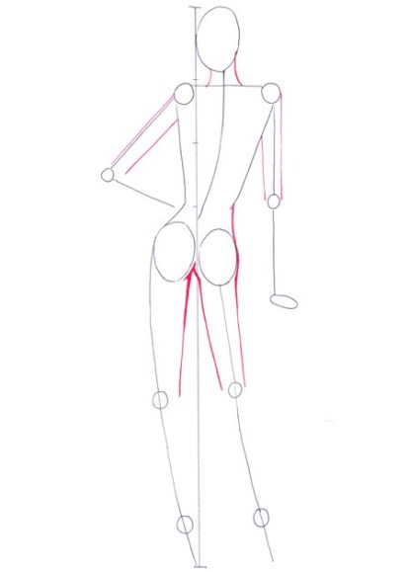
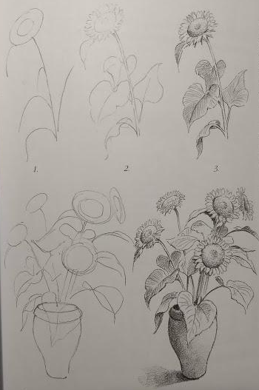
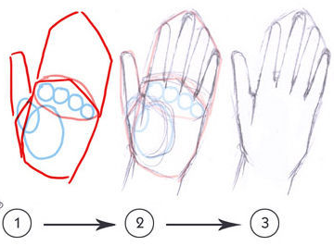
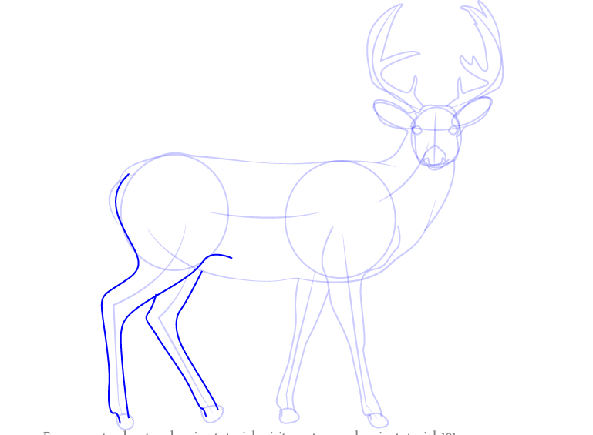
Form
Start outline by using basic shapes
Refine the basic shapes with more detail and intricate lines and curves
Double-check your proportion
Erase gestural lines (if necessary)

Slide 7
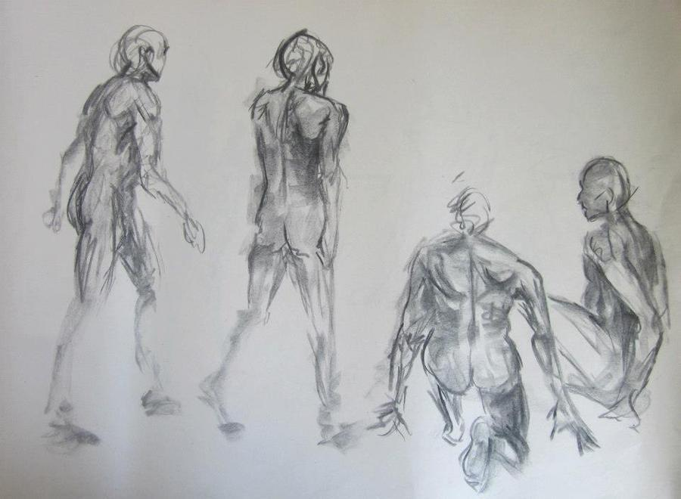
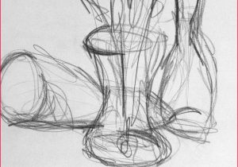
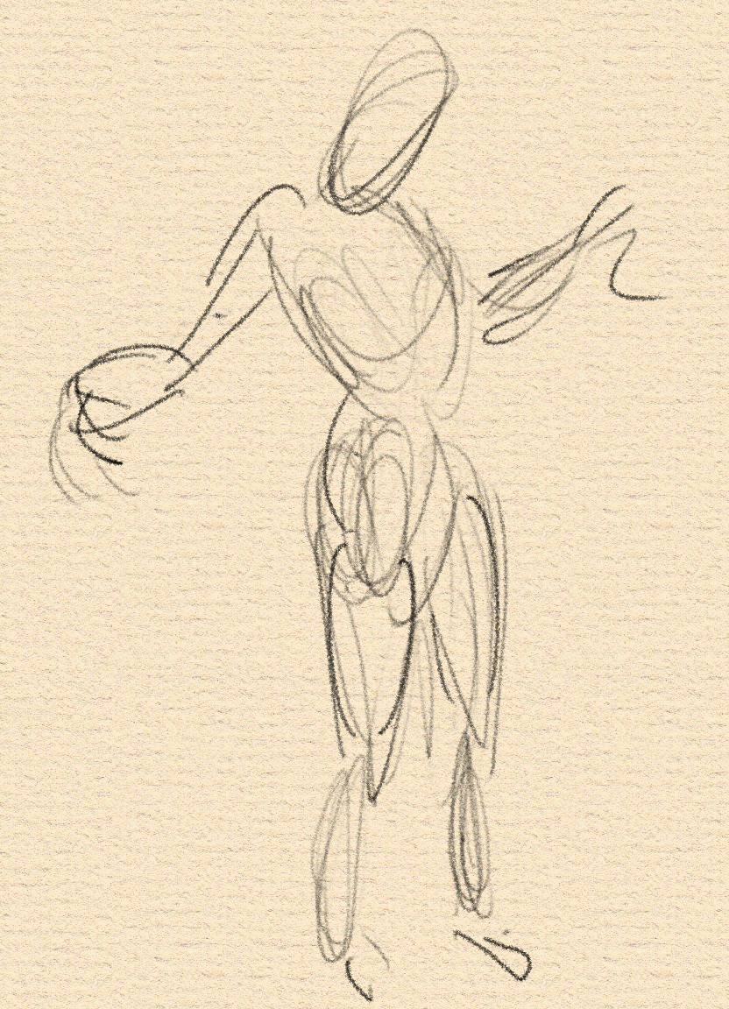
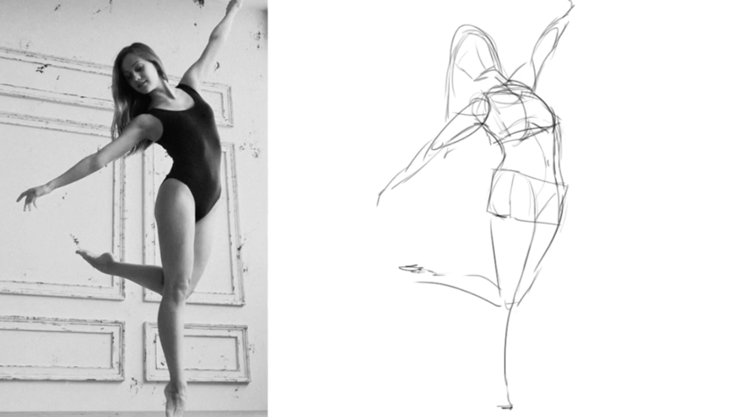
Gesture
Capture essence of image
Use swift, flowing sketch lines
Doesn’t need to be exact
Many different ways to do gesture
What’s your style?

Slide 8
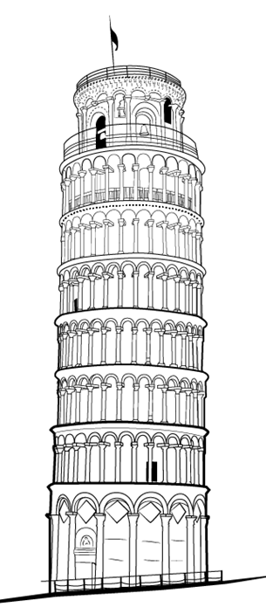
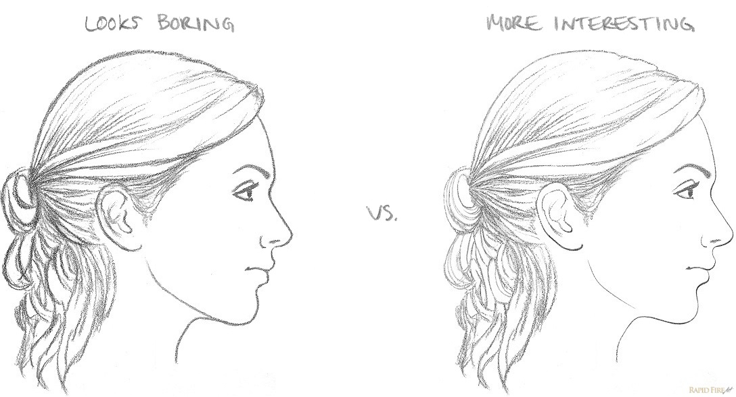
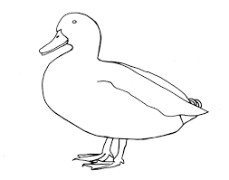

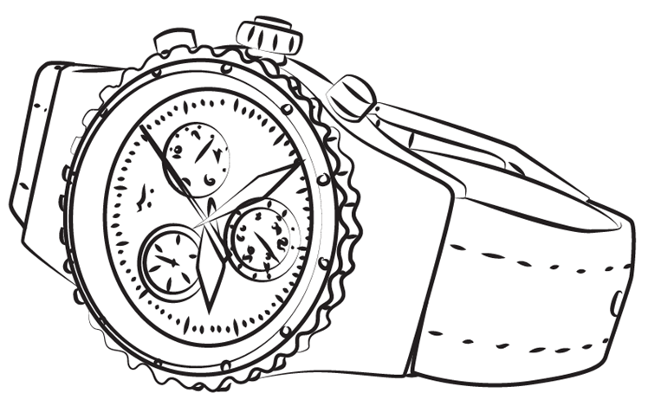
Line Drawing
No shading, just lines
Lines are realistic and proportional
Mainly outlines with some lines to include important detail

Slide 9
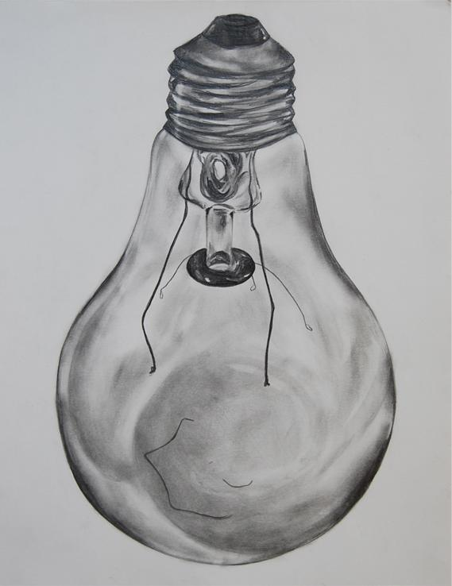
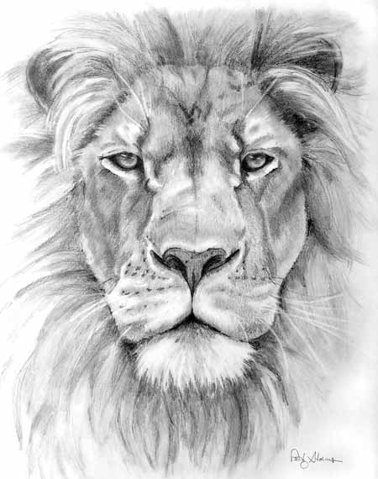
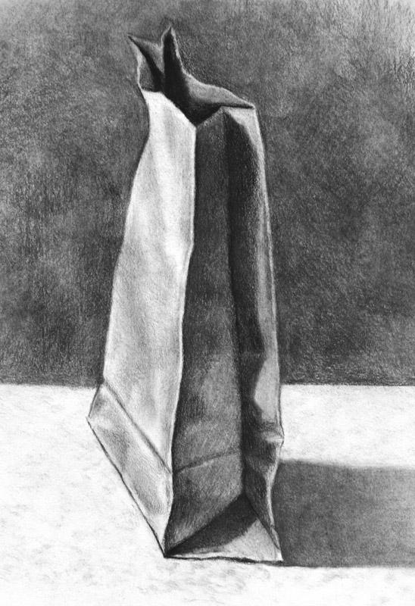
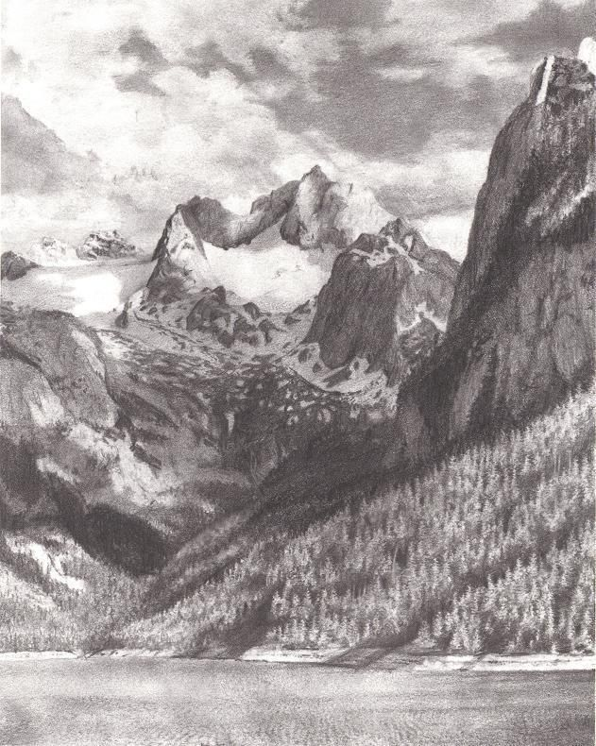
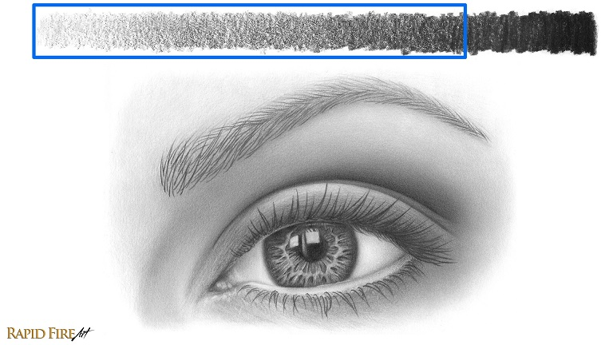
Value Drawing
Uses various shading techniques
Explores the range of shadows, midtones, and highlights
Creates three-dimensional illusion

Slide 10
Using Charcoals
It’s a little different than graphite!

Slide 11
In your bags, you should have:
Compressed charcoal
(rectangular, heavier, harder)
Vine charcoal
(cylindrical, lighter, softer)
Conté
(white, compressed)
Kneaded Eraser
(gray, square)
Toned drawing paper
(acts as midtone)
Paper with piece of masking tape
(for smudging in small spots)
Paper towel
(for smudging, keeping clean)
Bookmark
(my email in case you want to reach out, ask any questions)

Slide 12
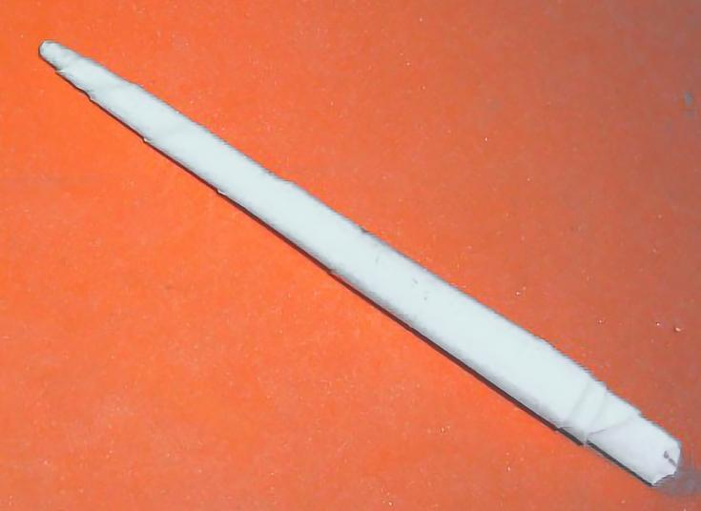
Making a tortillion
(Used as a blending stump, to smudge small details!)
Take one of the long corners, make a crease almost to the middle angle of the triangle.
Keep rolling tightly, increasing the angle on the long side, keeping near the same point where the crease ended.
Use tape to secure ends.

Slide 13
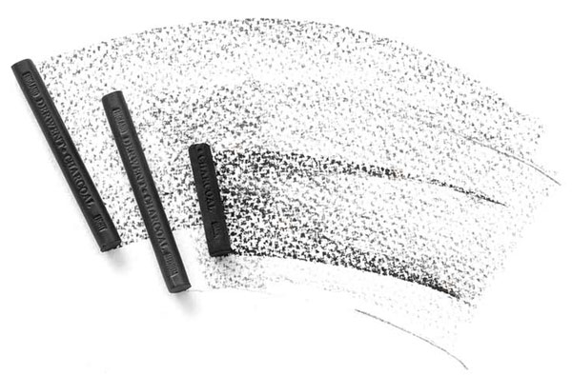
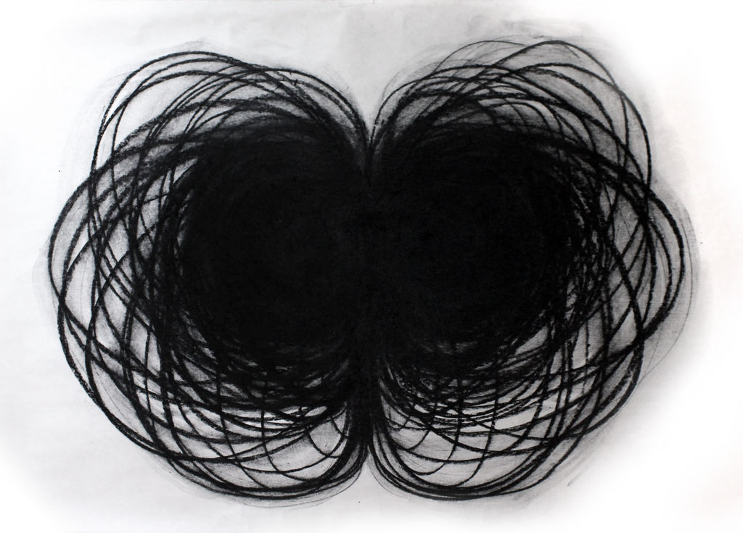
Compressed charcoal
Made from charcoal powder with binding agent
Creates harsh lines and dark shades
Start with lightest touch and work up from there
A little bit goes a long way, especially with smudging
Hard to erase once it’s on the paper--get shapes right with vine charcoal first

Slide 14
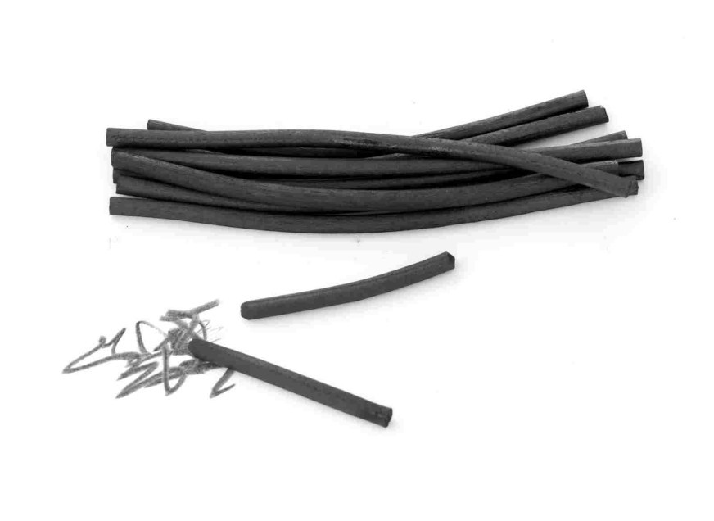
Vine charcoal
Actual grape vine or willow twigs that are burned down; no binder
Very erasable, smudgeable, malleable
Perfect for sketching, gestural lines
Also helps create softer shades and refining smudging
Makes achieving “sfumato” effect much easier

Slide 15
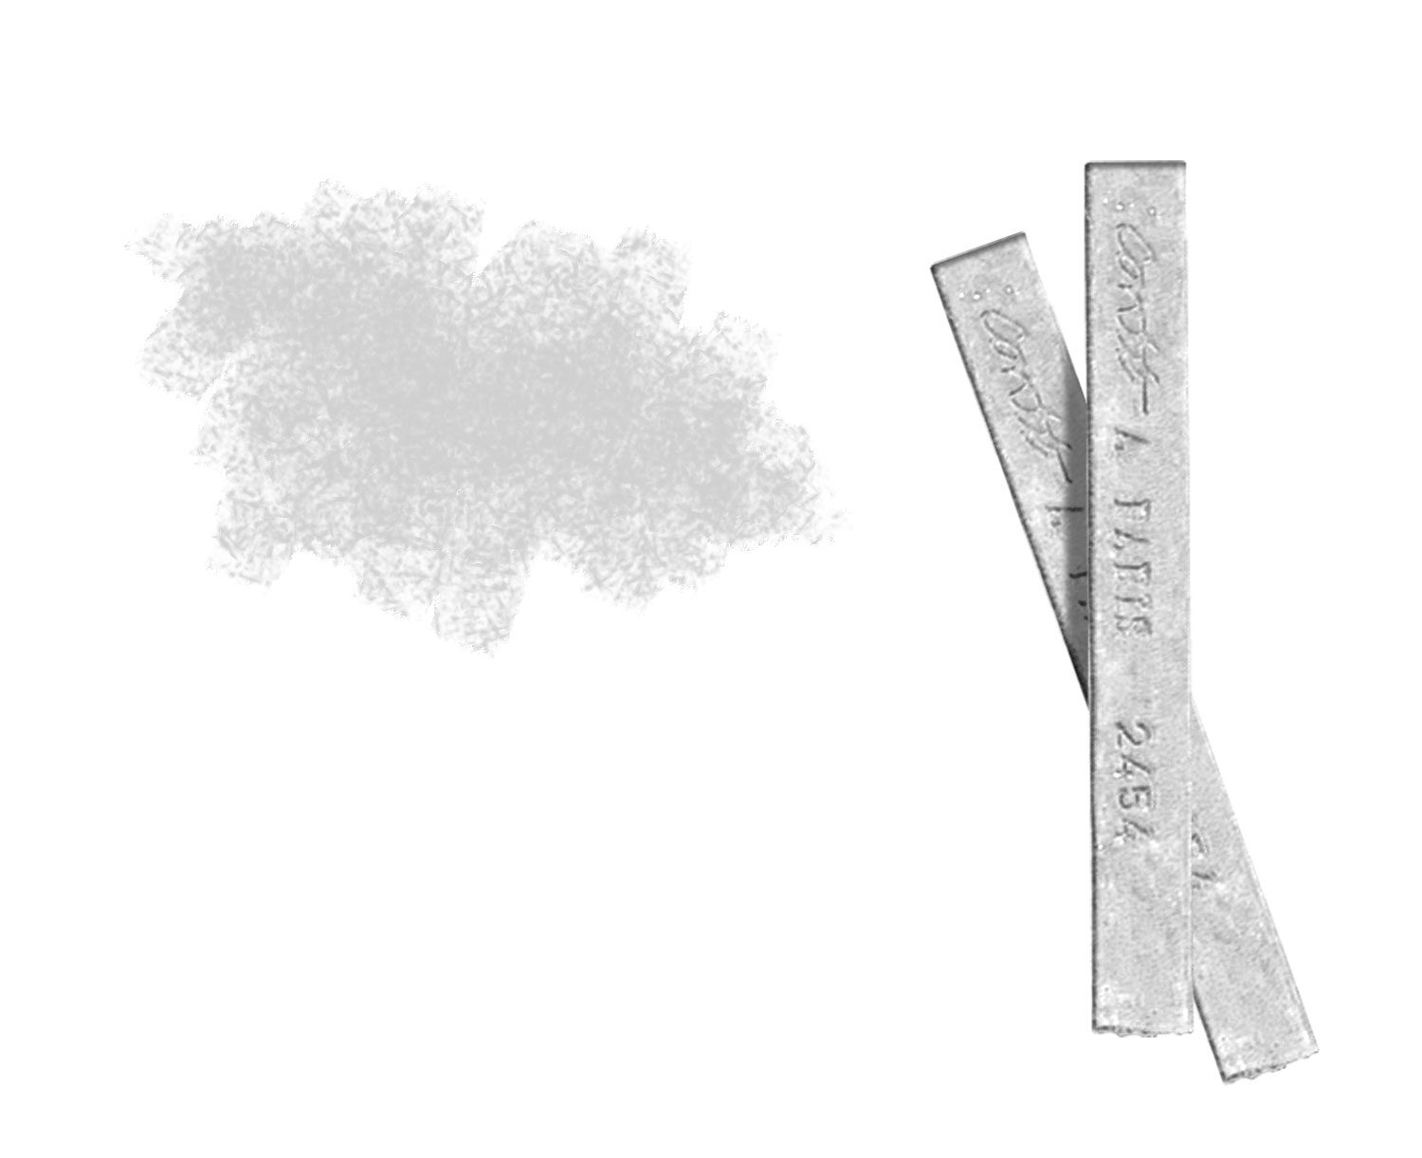
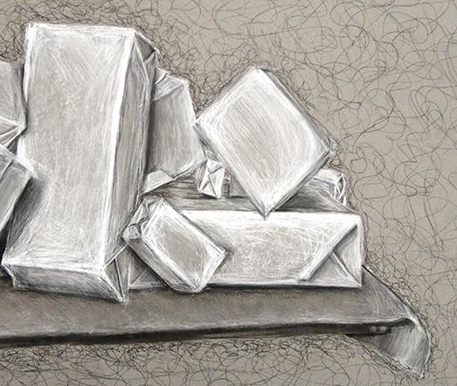
Conté
Compressed chalk powder with binding agent
Creates harsh lines or highlights and lightest shades
Start with lightest touch and work up from there
Hard to erase once it’s on the paper
Used at the end to achieve untouched, lightest shades

Slide 16
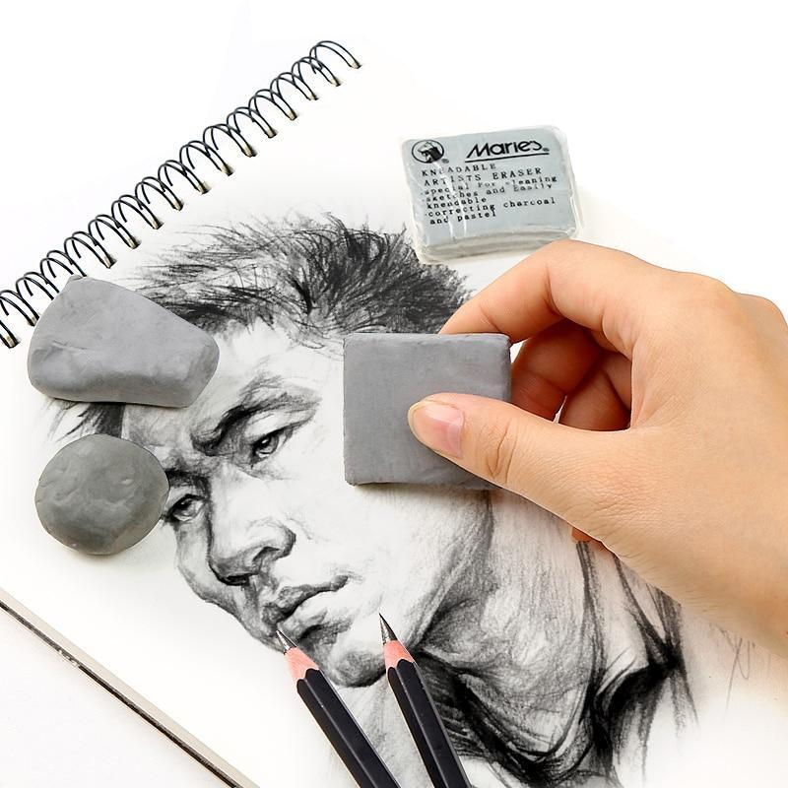
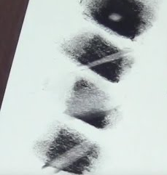
Kneaded Eraser
Meant specifically for charcoal, although can be used for graphite
To remove charcoal from the eraser surface, simply knead the eraser--the more it’s stretched, the less charcoal there is within it
Can be formed into smaller shapes to help refine detail
Can be used to create lighter shades by erasing in smudged areas

Slide 17
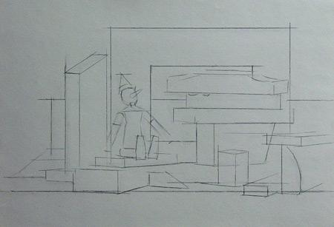
Step-by-step
Figure out what part of the still life you want to draw, and use gesture lines to map the silhouette out on your page
Use vine charcoal to create basic geometric shapes, and/or get gesture of objects
Keep refining shapes with vine charcoal, and smudge away unwanted lines as you go
Once happy with shapes, erase unwanted lines

Slide 18
Step-by-step
Figure out what part of the still life you want to draw, and use gesture lines to map the silhouette out on your page
Use vine charcoal to create basic geometric shapes, and/or get gesture of objects
Keep refining shapes with vine charcoal, and smudge away unwanted lines as you go
Once happy with shapes, erase unwanted lines

Slide 19
Step-by-step
Figure out what part of the still life you want to draw, and use gesture lines to map the silhouette out on your page
Use vine charcoal to create basic geometric shapes, and/or get gesture of objects
Keep refining shapes with vine charcoal, and smudge away unwanted lines as you go
Once happy with shapes, erase unwanted lines

Slide 20
Step-by-step
Figure out what part of the still life you want to draw, and use gesture lines to map the silhouette out on your page
Use vine charcoal to create basic geometric shapes, and/or get gesture of objects
Keep refining shapes with vine charcoal, and smudge away unwanted lines as you go
Once happy with shapes, erase unwanted lines

Slide 21
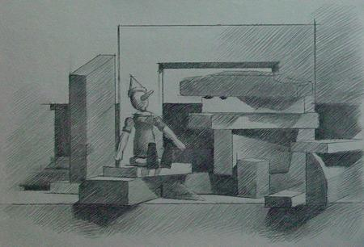
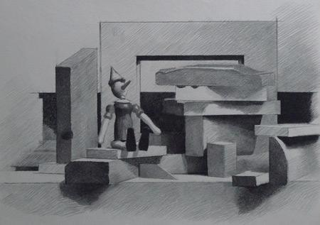
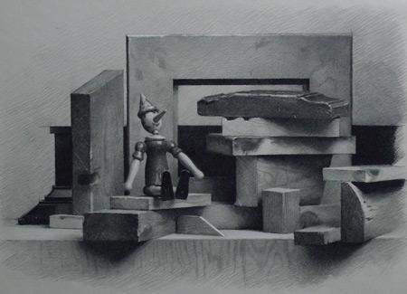
Step-by-step
Use vine charcoal to create basic shapes
Refine shapes with vine charcoal
Once happy with shapes, erase or sm
udge away unwanted lines
Use compressed charcoal to get midtones and darker edges;create value with soft hatching or shading
Smooth out values, to create 3-D illusion
Clean up unwanted lines and marks, clean/wipe hands
Use conte for lighter than midtone to lightest highlights
Do final touch-ups, and one last erasing of any unwanted marks; clean up lines and edges
Step-by-step

Slide 22
Step-by-step
Use vine charcoal to create basic shapes
Refine shapes with vine charcoal
Once happy with shapes, erase or sm
udge away unwanted lines
Use compressed charcoal to get midtones and darker edges;create value with soft hatching or shading
Smooth out values, to create 3-D illusion
Clean up unwanted lines and marks, clean/wipe hands
Use conte for lighter than midtone to lightest highlights
Do final touch-ups, and one last erasing of any unwanted marks; clean up lines and edges
Step-by-step

Slide 23
Step-by-step
Use vine charcoal to create basic shapes
Refine shapes with vine charcoal
Once happy with shapes, erase or sm
udge away unwanted lines
Use compressed charcoal to get midtones and darker edges;create value with soft hatching or shading
Smooth out values, to create 3-D illusion
Clean up unwanted lines and marks, clean/wipe hands
Use conte for lighter than midtone to lightest highlights
Do final touch-ups, and one last erasing of any unwanted marks; clean up lines and edges
Step-by-step

Slide 24
Step-by-step
Use vine charcoal to create basic shapes
Refine shapes with vine charcoal
Once happy with shapes, erase or sm
udge away unwanted lines
Use compressed charcoal to get midtones and darker edges;create value with soft hatching or shading
Smooth out values, to create 3-D illusion
Clean up unwanted lines and marks, clean/wipe hands
Use conte for lighter than midtone to lightest highlights
Do final touch-ups, and one last erasing of any unwanted marks; clean up lines and edges
Step-by-step

Slide 25
Step-by-step
Use vine charcoal to create basic shapes
Refine shapes with vine charcoal
Once happy with shapes, erase or sm
udge away unwanted lines
Use compressed charcoal to get midtones and darker edges;create value with soft hatching or shading
Smooth out values, to create 3-D illusion
Clean up unwanted lines and marks, clean/wipe hands
Use conte for lighter than midtone to lightest highlights
Do final touch-ups, and one last erasing of any unwanted marks; clean up lines and edges
Step-by-step

Slide 26
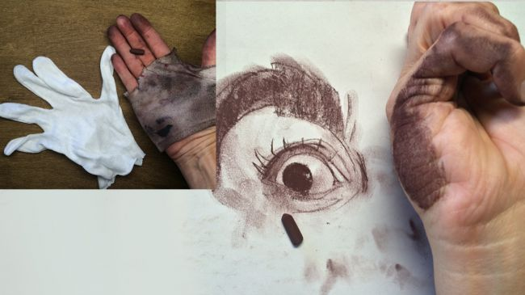
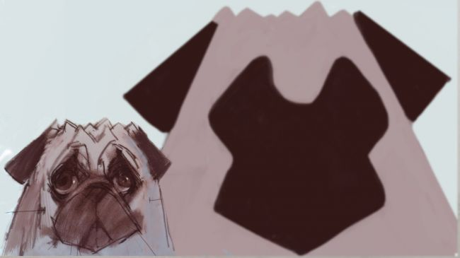
Helpful Tips
Use hands to create a rectangle to help map out your composition
Work from left to right if right-handed, or work right to left if left-handed--keeps paper clean
When assessing value, squint to see values more starkly
Use paper towel to smudge and protect your hand from your paper; oils from your fingers and hands make charcoal marks hard to erase

Slide 27
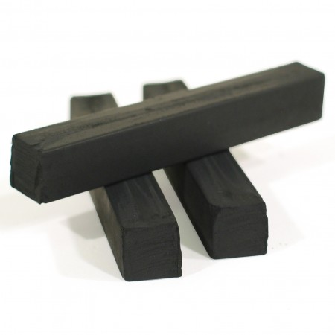
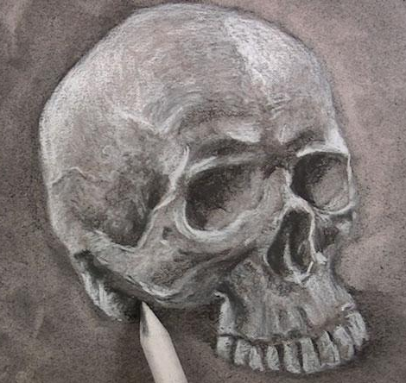
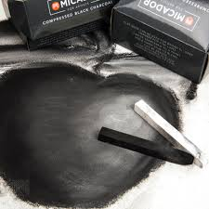
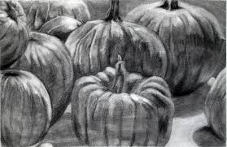
Helpful Tips
Keep some corners of compressed charcoal and conté sharp, so that you can use them for fine detail
Feel free to blend conté with charcoal to see what happens, how it differs from the gray on the paper
Every once in awhile, stretch out your drawing in front of you at arms length to improve perspective
Keeping paper clean helps organize your drawing, keeping irrelevant visual noise quiet

Slide 28
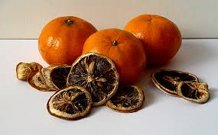
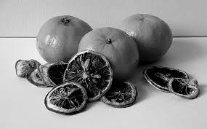
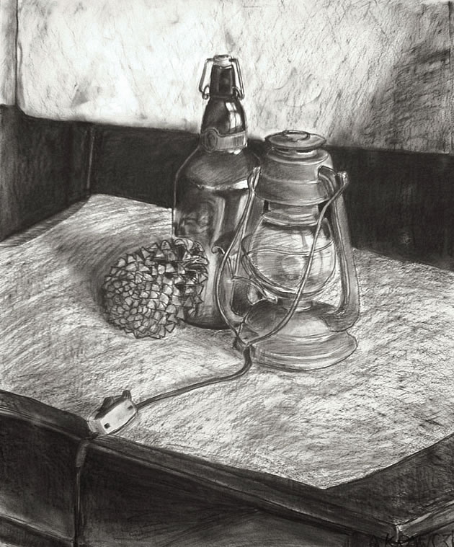
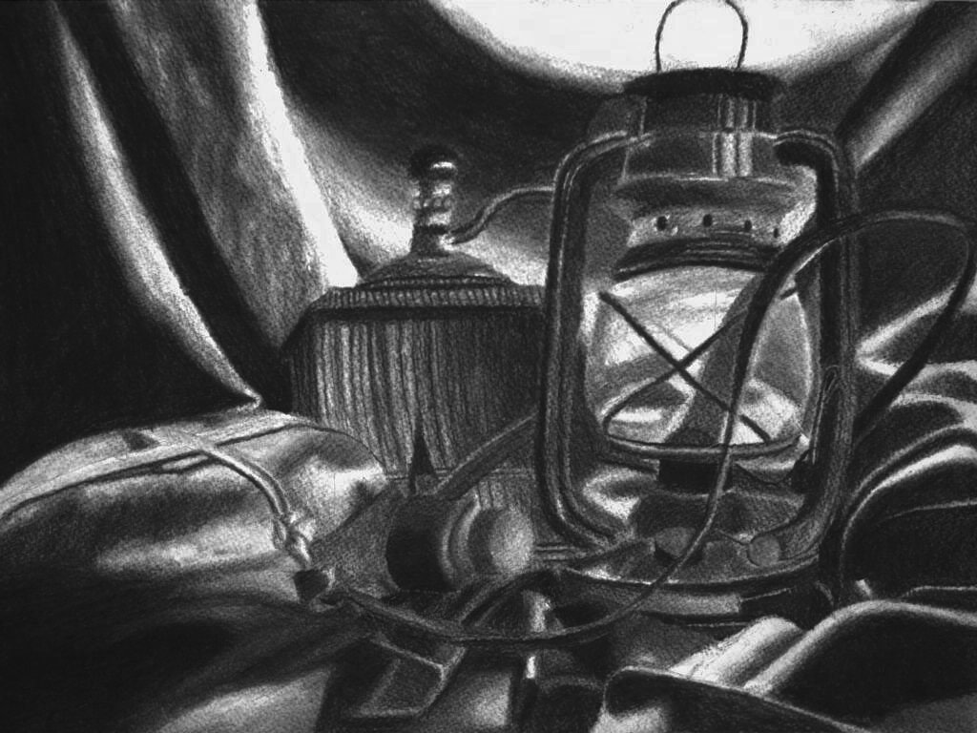
Things to Think About:
Do you draw everything large and up-close? Or small and detailed?
Do you want to draw basic detail on the whole still life, or more complex detail on a close-up perspective?
What are your lightest and darkest shades that you can see?
How do the colors translate into value?
Notes:
Do you like to have really soft, sfumato type of texture, linear hatching texture, or chaotic scumbling texture?

Slide 29
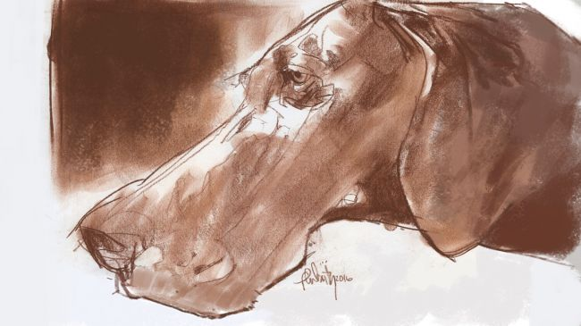
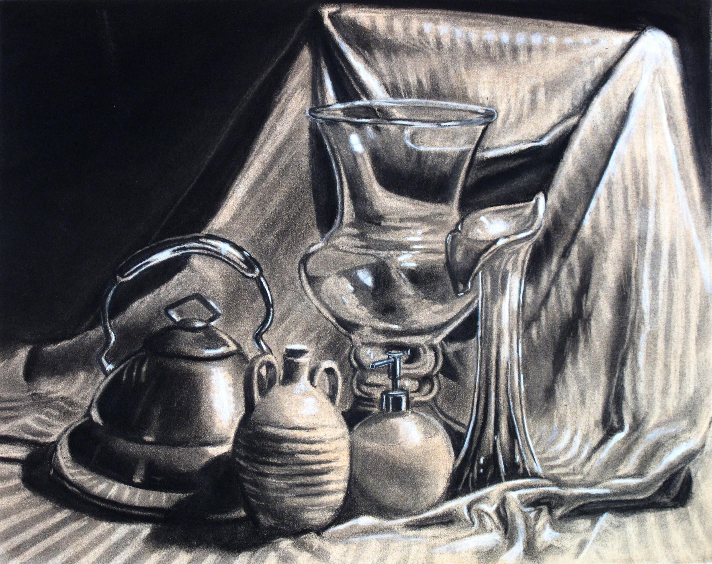
Things to Think About:
Do you like contrast? Harsh or soft lines? Are you loose and expressive, or more organized and realistic?
How do shades you see compare to shade of toned paper?
Do you like the really soft smudging type of texture, linear hatching texture, or more chaotic scumbling texture?
What makes your drawing style unique compared to others?

Slide 30
Still Life Drawing
Test out what you just learned!

