Slide 1
Drawing Class #4!
Presented by Karen Kliethermes

Slide 2
Professor Raj’s Next Assignment
Basic project guidelines:
Must be a drawing with text
Subject is open--could be anything!
Vision of either the past or present
Prof. Raj wants you to have an idea in mind this week for this future assignment

Slide 3
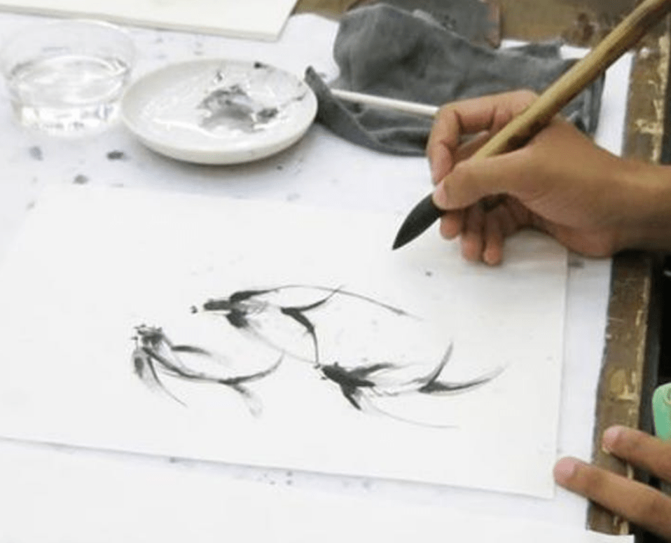
Today’s Goals:
Strengthen previously learned drawing skills
Expand drawing skills using ink and brush!
Challenge ability to achieve value with ink
Explore your own artistic way! Are you realistic? Abstract? Expressionistic?

Slide 4
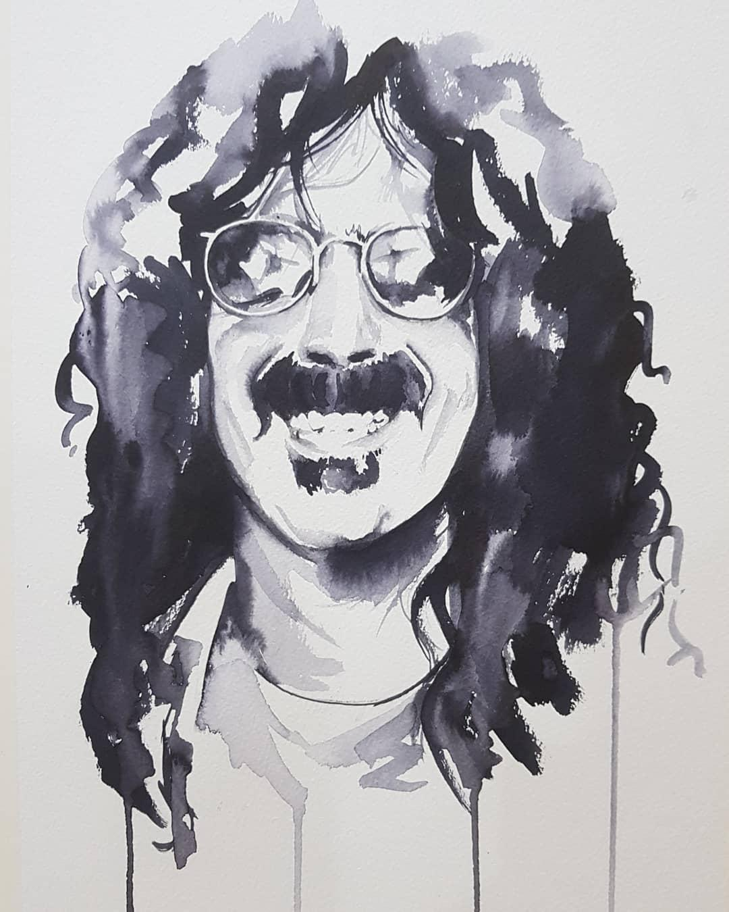
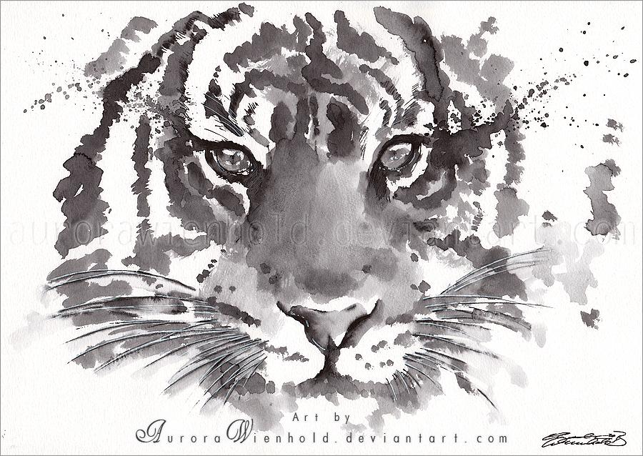
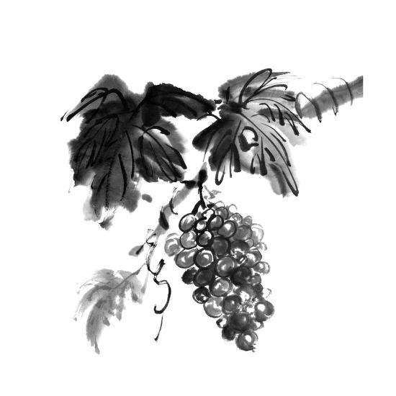
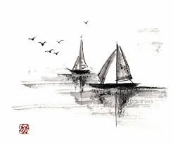
Using Ink and Brush
Achieve different values through specific ratios of ink to water
More ink in mixture yields darker tones, more water in mixture yields lighter tones
Ink is tricky and unpredictable!

Slide 5
Using Ink and Brush
Once ink is on the page, you can’t really remove it--part of it’s charm
Can be more expressionistic and abstract rather than perfectly realistic
Ink drawing/painting focuses more on line quality and texture to convey subject

Slide 6
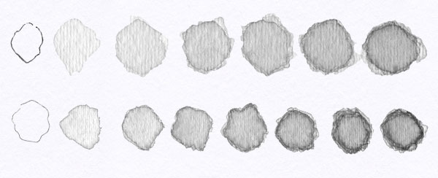
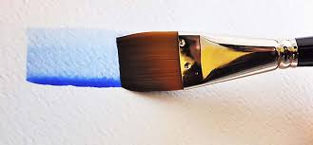
Today’s Tips:
Use lid of water cup as an ink wash developer
You can dip brush in water, then in ink, and mix it around on the lid to see the wash before it’s on paper
Add more ink to wash as you go to achieve darker colors
You can use the ink without water to get darkest tones after lightest tones are established
Notes:
A little ink goes a long way!
Once an ink wash dries, you cannot manipulate it, only add onto it
You can layer ink washes on top of each other to darken them
Be careful not to get on clothes--it will stain! If you do, rinse immediately
Be careful not to get on clothes--it will stain! If you do, rinse immediately

Slide 7
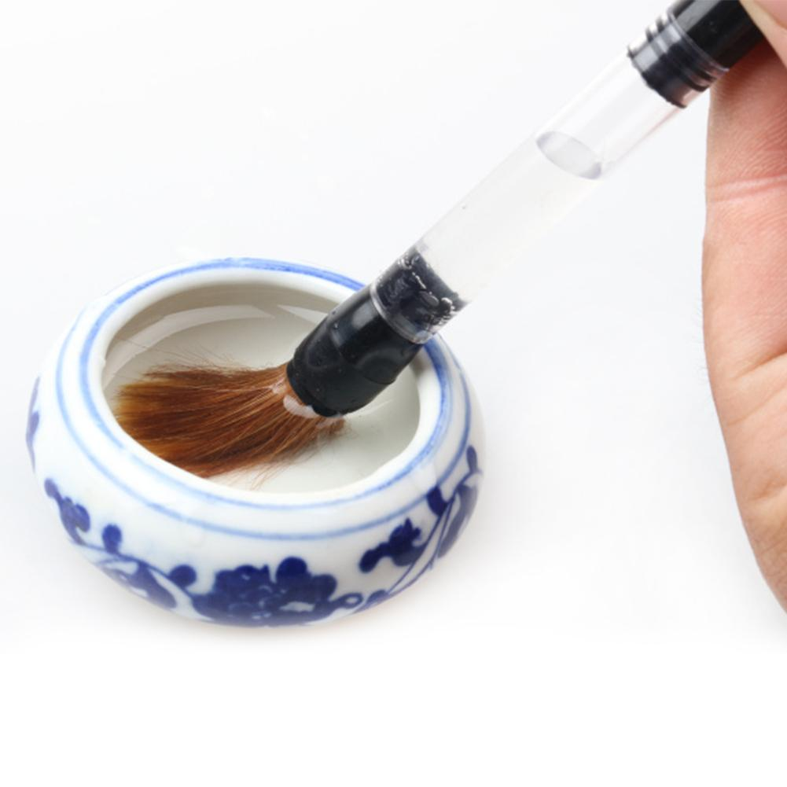
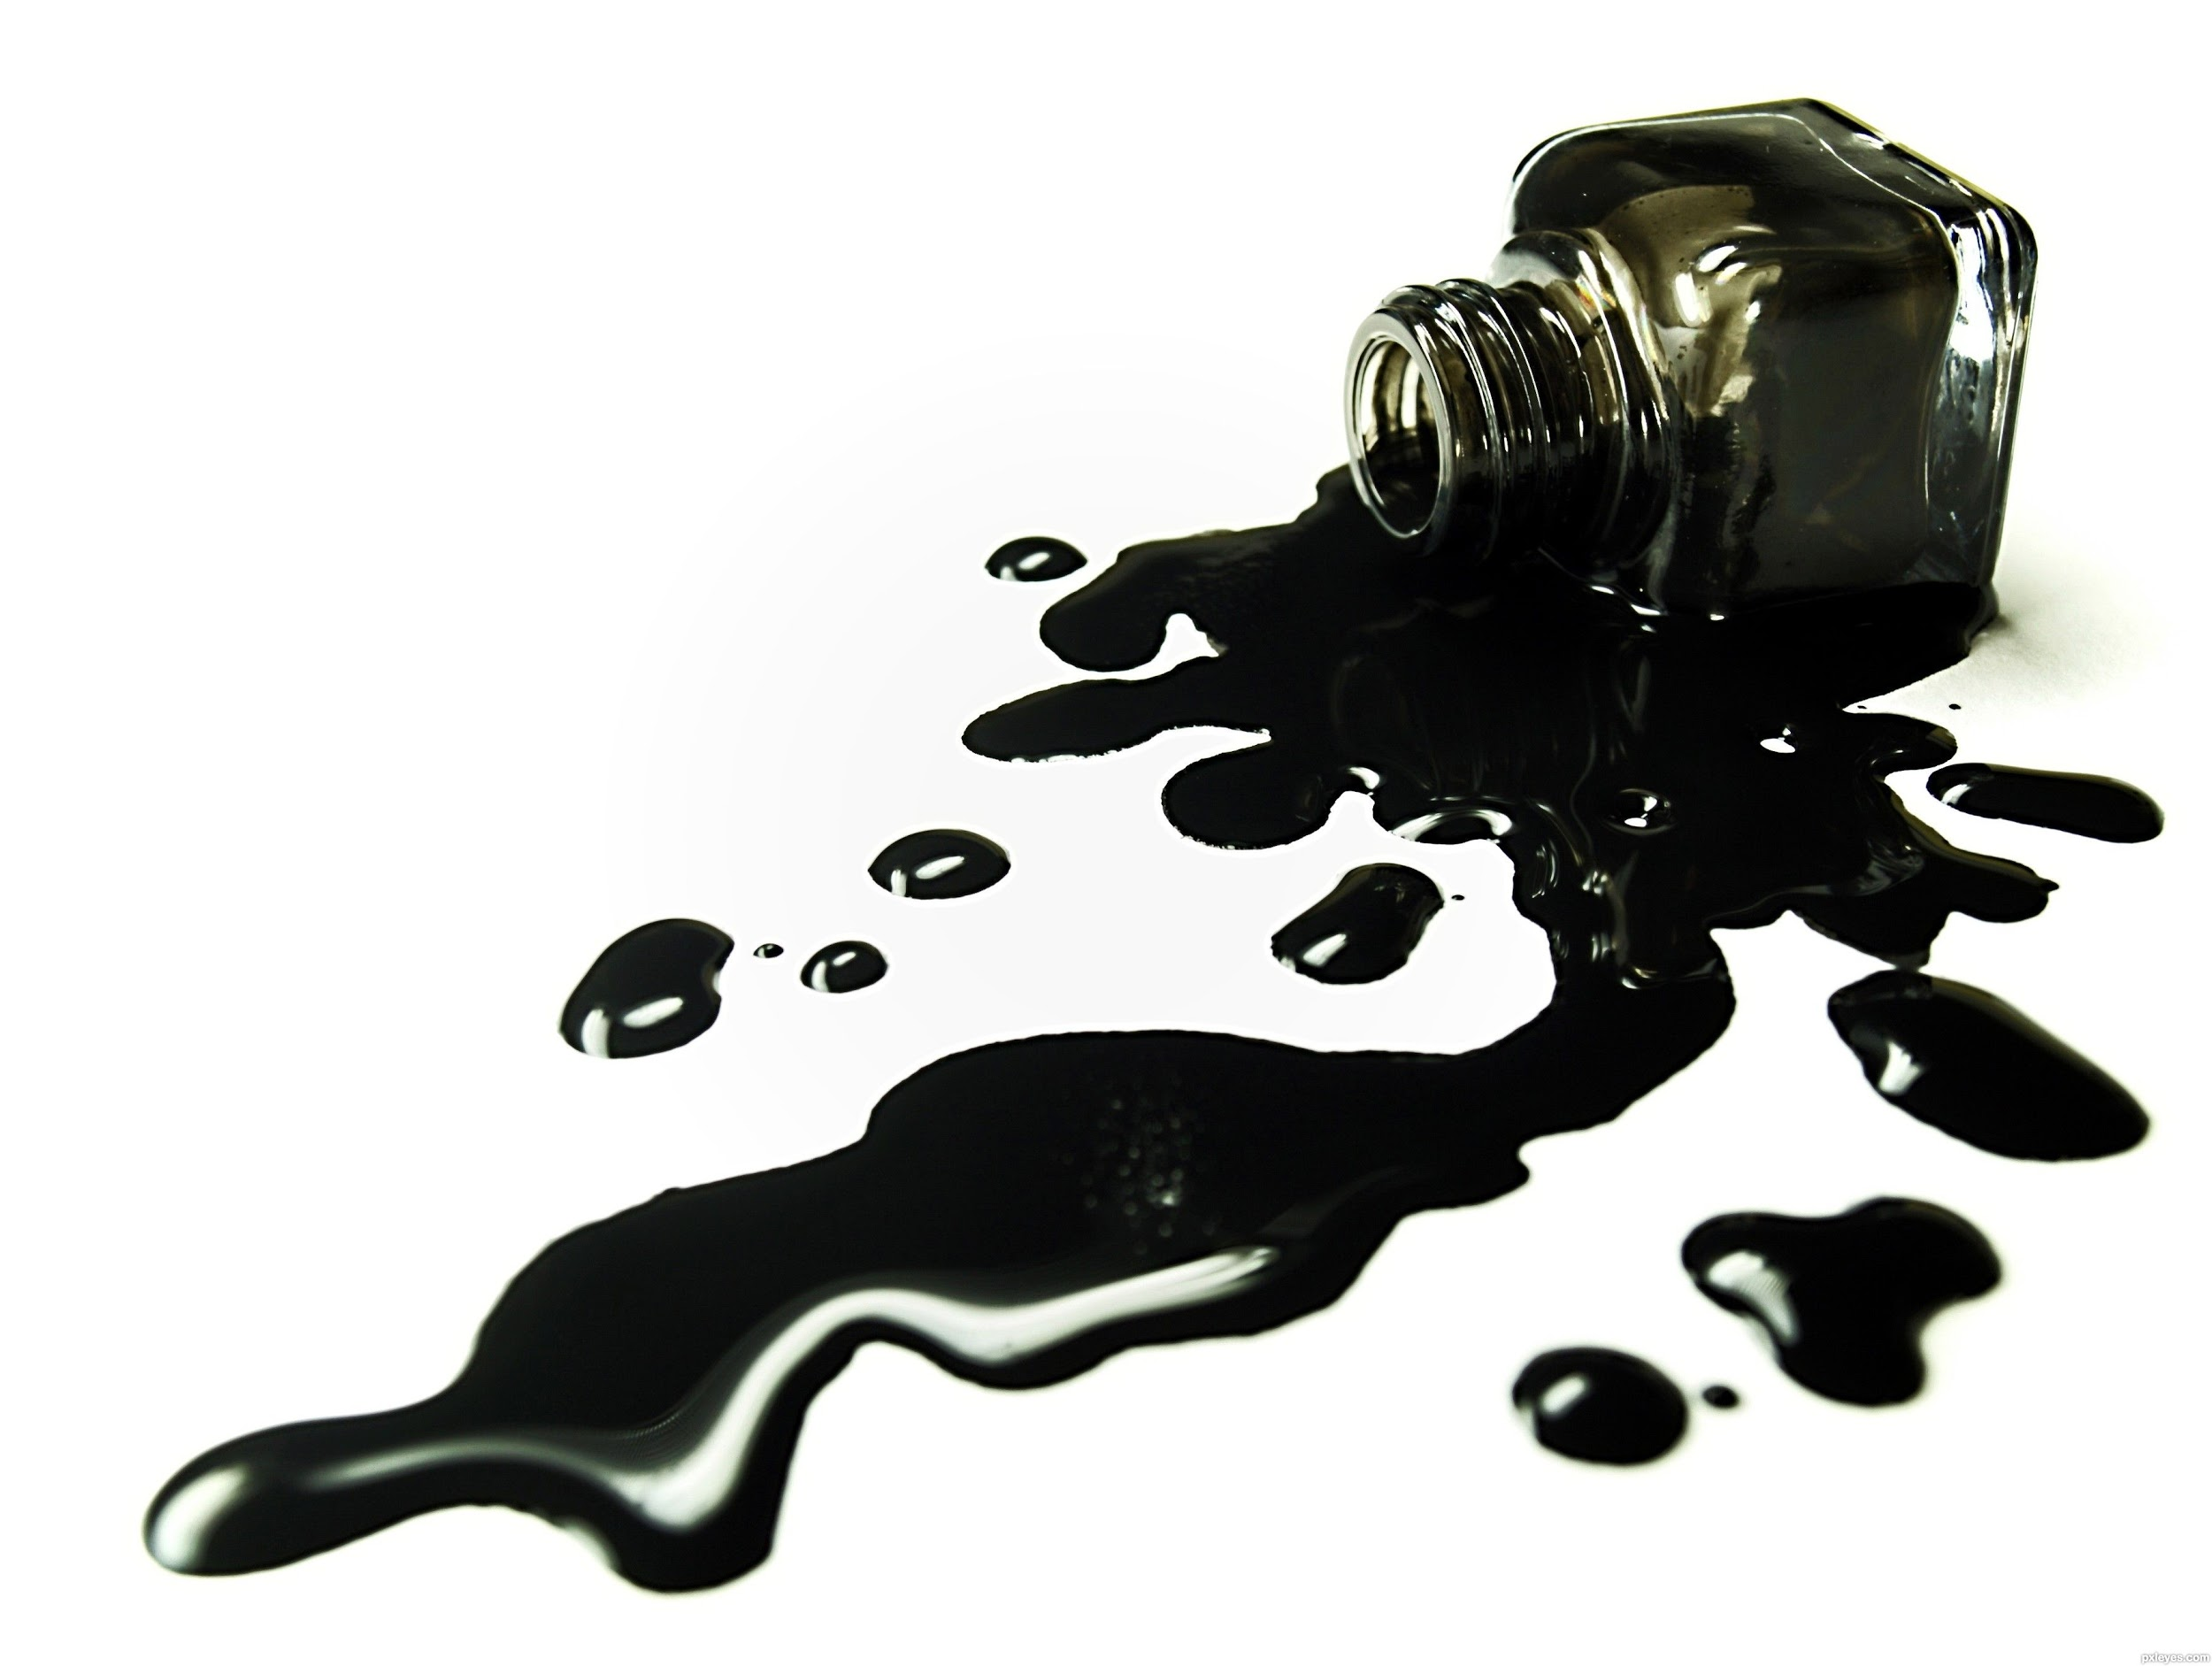
Today’s Tips:
A little ink goes a long way!
Once an ink wash dries, you cannot manipulate it, only add onto it
You can layer ink washes on top of each other to darken them
Be careful to not get ink on your clothes! If you do, rinse immediately
Notes:
A little ink goes a long way!
Once an ink wash dries, you cannot manipulate it, only add onto it
You can layer ink washes on top of each other to darken them
Be careful not to get on clothes--it will stain! If you do, rinse immediately
Be careful not to get on clothes--it will stain! If you do, rinse immediately

Slide 8
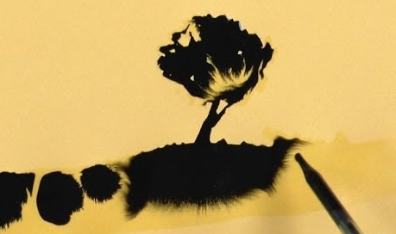
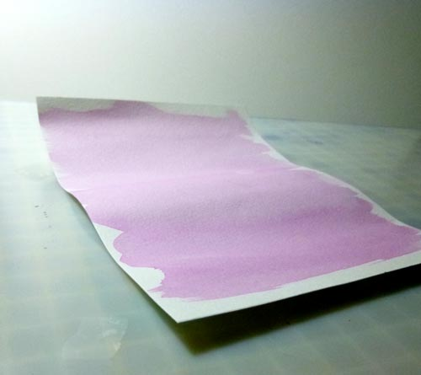
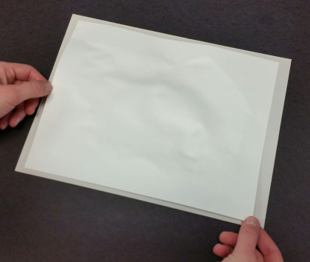
Today’s Tips:
If your paper gets too saturated with water:
The paper will warp, or “buckle”
The ink will spread out when in contact with the wet portion of the paper
To avoid this, use the edge of your water cup to remove excess water from your brush before applying on paper
Notes:
Be careful not to get on clothes--it will stain! If you do, rinse immediately
Be careful not to get on clothes--it will stain! If you do, rinse immediately

Slide 9
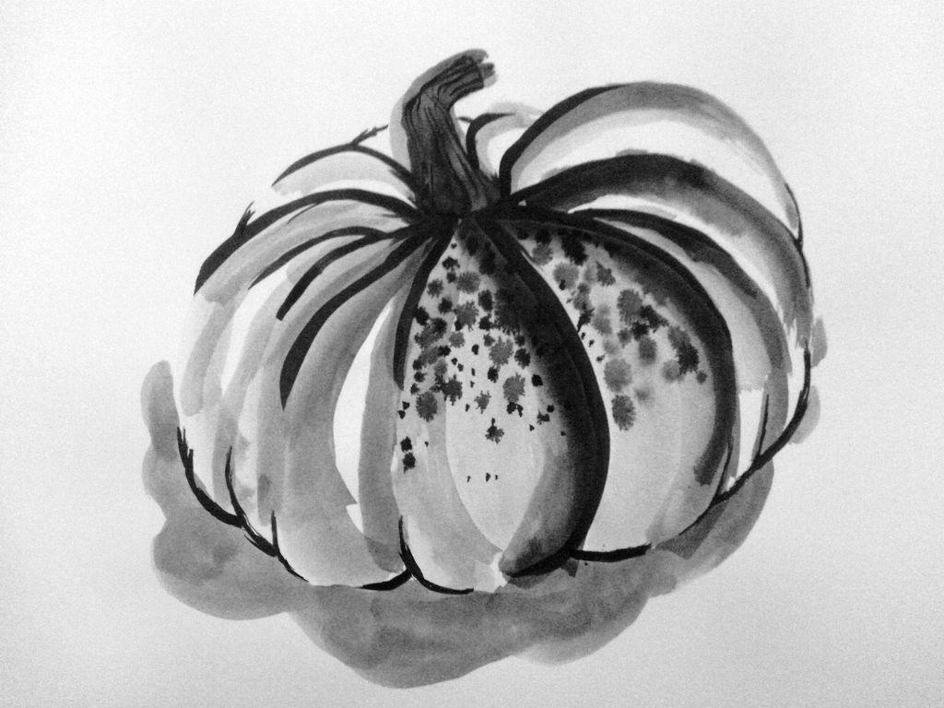
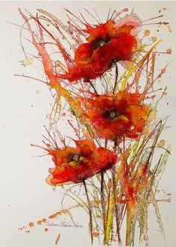
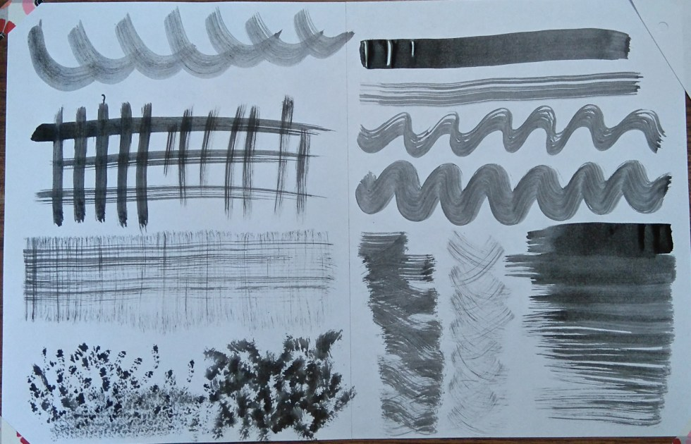
Today’s Tips:
Leave the lightest parts of the nature object untouched, so that it’s white like the paper
Use the shape of your brush to your advantage--you can create textures with the different brush shapes
Other techniques include: blowing on ink, splattering with brushes, alcohol or salt to change texture of ink, dropping ink onto painted water on paper
Notes:
Be careful not to get on clothes--it will stain! If you do, rinse immediately
Be careful not to get on clothes--it will stain! If you do, rinse immediately

Slide 10
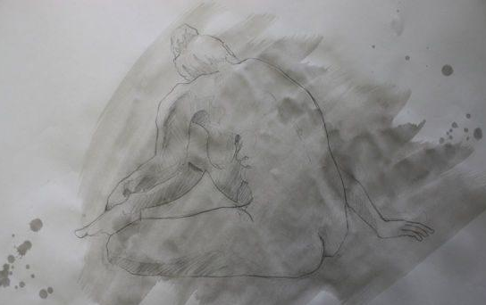
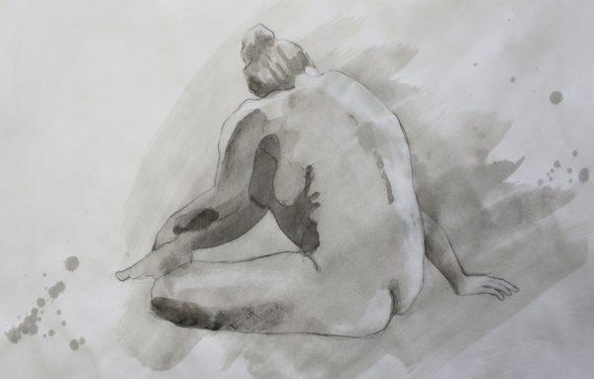
Today’s Steps!
In pencil, gesture drawing of nature object
(Lightly) in pencil, line drawing of nature object
Start with lighter ink washes, covering majority of line drawing
Move up slowly to your midtones, then darkest tones and details last

Slide 11
Thank You! :)
Presented by Karen Kliethermes

